Slide 1

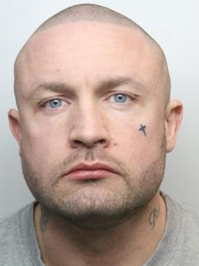
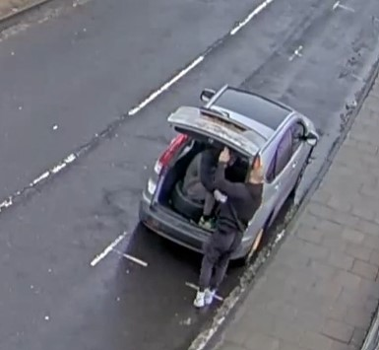
NATIONAL
NEWSLETTER
Spring/summer 2024
Two landmark cases mark 20th anniversary year for Stop Loan Sharks
2024 marks the 20th anniversary of the England Illegal Money Lending Team, or Stop Loan Sharks.
The year has already seen two landmark cases – one which saw one of the highest ever amounts confiscated following a Proceeds of Crime hearing and one of the longest sentences handed to a loan shark.
We have also had Stop Loan Sharks Week which saw some amazing figures.
At least 520 partner organisations downloaded our social media toolkit and shared posts online.
Many also used our specially-themed blog for newsletters and websites to make sure the message reached clients who may be at risk.
In total we reached more than 442,595 people.
Thanks to everyone who has supported us so far - we have plenty more to come in this anniversary year so watch this space.
Ruthless loan shark who made borrower travel in boot of car
is locked up for seven years
A vicious loan shark who kidnapped a vulnerable borrower, forcing him to travel in the boot of his car to get cash and broke his jaw during an attack when he couldn’t meet a repayment has been jailed for seven years.
Richard Dawson, aged 35, from Barnsley, appeared at Sheffield Crown Court where he was told by the judge, Mr Recorder Adrian Langdale KC he was clearly involved in an ‘organised crime extortion racket’ and trapped his victims in a ‘cycle of debt and despair’.
He said Dawson treated the borrower ‘little better than an animal rather than the human being he was’ and like a ‘walking cash machine’.
Dawson, of Hill End Close, admitted charges of illegal money lending, money laundering and kidnap. He also admitted assault causing grievous bodily harm and assault causing actual bodily harm against one person and assaulting a second victim, causing actual bodily harm.
The case was prosecuted by the England Illegal Money Lending Team (IMLT) working in partnership with Barnsley Council Safer Neighbourhoods Service and South Yorkshire Police.
The court heard it became common practice for the victim to be forced to travel in the boot of Dawson’s car to withdraw money from a cash machine. The victim was clearly terrified when speaking about Dawson and was fearful for his life.
Richard Dawson
Read the full story and watch the CCTV footage here

Slide 2


£1.5m confiscated from loan sharks this year
We have had some major Proceeds of Crime confiscation orders so far this year, with loan sharks ordered to pay more than £1.5 million in total. That includes one case where two illegal lenders were told they must pay £1.2 million, one of the largest ever single confiscation orders seen from an IMLT case.
Some of this money will help in the fight against loan sharks in England.
London
Staffordshire
Two loan sharks have been told to hand over £1.2 million in one of the largest ever Proceeds of Crime confiscation orders for the England Illegal Money Lending Team.
Luz Guerra Villar, aged 67, and 71-year-old Leticia Manipol were given suspended jail sentences in 2021 after admitting illegal money lending and money laundering charges.
Kingston Crown Court heard the two women, of Church Lane, Tooting, had lent over £4.2 million to fellow Filipinos across South London, many of whom worked at a London hospital. They operated over a 16-year period.
The case was back before the court on Tuesday, April 16, when Judge Marcus Tregilgas-Davey heard the pair had benefited to the tune of £1.2 million between them.
They were each given a confiscation order for £600,000, which must be paid within three months or they could face a jail term of up to six years.
A Staffordshire loan shark who was jailed for four and a half years has now been told he must pay more than £16,000.
Mantas Daujotas aged 39, from Burton upon Trent, ran an illegal lending operation with at least 260 customers. He was sentenced at Stafford Crown Court last June after admitting illegal lending, money laundering and unlawful possession of identity documents.
His case was back before the court in May when a confiscation order was made for £16,333 under the Proceeds of Crime Act. The court heard that figure was the amount of realisable assets available.
The court last year heard Daujotas left the country after his arrest and the IMLT worked in partnership with Staffordshire Police and other law enforcement agencies to ensure he was forced to return to face justice.
Kent
Sunderland
Surrey
A hospital worker from Kent who ran an illegal money lending operation giving loans to colleagues has been handed a court confiscation order for more than £6,000.
Malai Gambrill, aged 56, was given a suspended prison sentence at Maidstone Crown Court in May last year after admitting lending to colleagues at Medway Maritime Hospital in Kent, where she worked as a caretaker. Gambrill, from Ingle Road, Chatham, lent around £80,000 in total to her colleagues, charging interest of around 60 per cent, even though she was not authorised by the Financial Conduct Authority. She was sentenced to 30 weeks in custody, suspended for 12 months and ordered to undertake 150 hours unpaid work.
A 51-year-old Sunderland man has been handed a court confiscation order for £2,959.25 after he admitted illegal money lending.
Graeme Lamb, of Seafields, was given a suspended sentence at Newcastle Crown Court in December last year after admitting illegal money lending and money laundering between 2014 and 2019. His mother Brenda Lamb, 83, of Bromarsh Court, Sunderland, admitted the same charge, but did not appear due to poor health. No confiscation order was made against her.
The court heard investigators found evidence of 361 loans being issued to 78 people ranging in value from £50 to £1,500. Interest rates of between 40% and 69.5% were charged. The pair were ordered to pay costs of £12,048.37.
A couple in their 70s who ran an illegal money lending business loaning over £2 million have been handed suspended sentences and ordered to pay £340,000.
Romeo and Merlita Magtibay, both aged 73, from Surrey, appeared before Kingston upon Thames Crown Court in February after admitting illegal money lending and money laundering.
They were each sentenced to 15 months in prison for illegal money lending and two years for money laundering, to run concurrently. The jail terms were suspended for 18 months.
Romeo Magtibay was handed a confiscation order for more than £12,900 and Merlita Magtibay for more than £330,000. The court heard that the Magtibays, of Albert Road, Mitcham, ran their illegal money lending operation between 2008 and 2019.
To read the full stories of these cases, go to www.stoploansharks.co.uk/news/
Other Proceeds of Crime cases

Slide 3
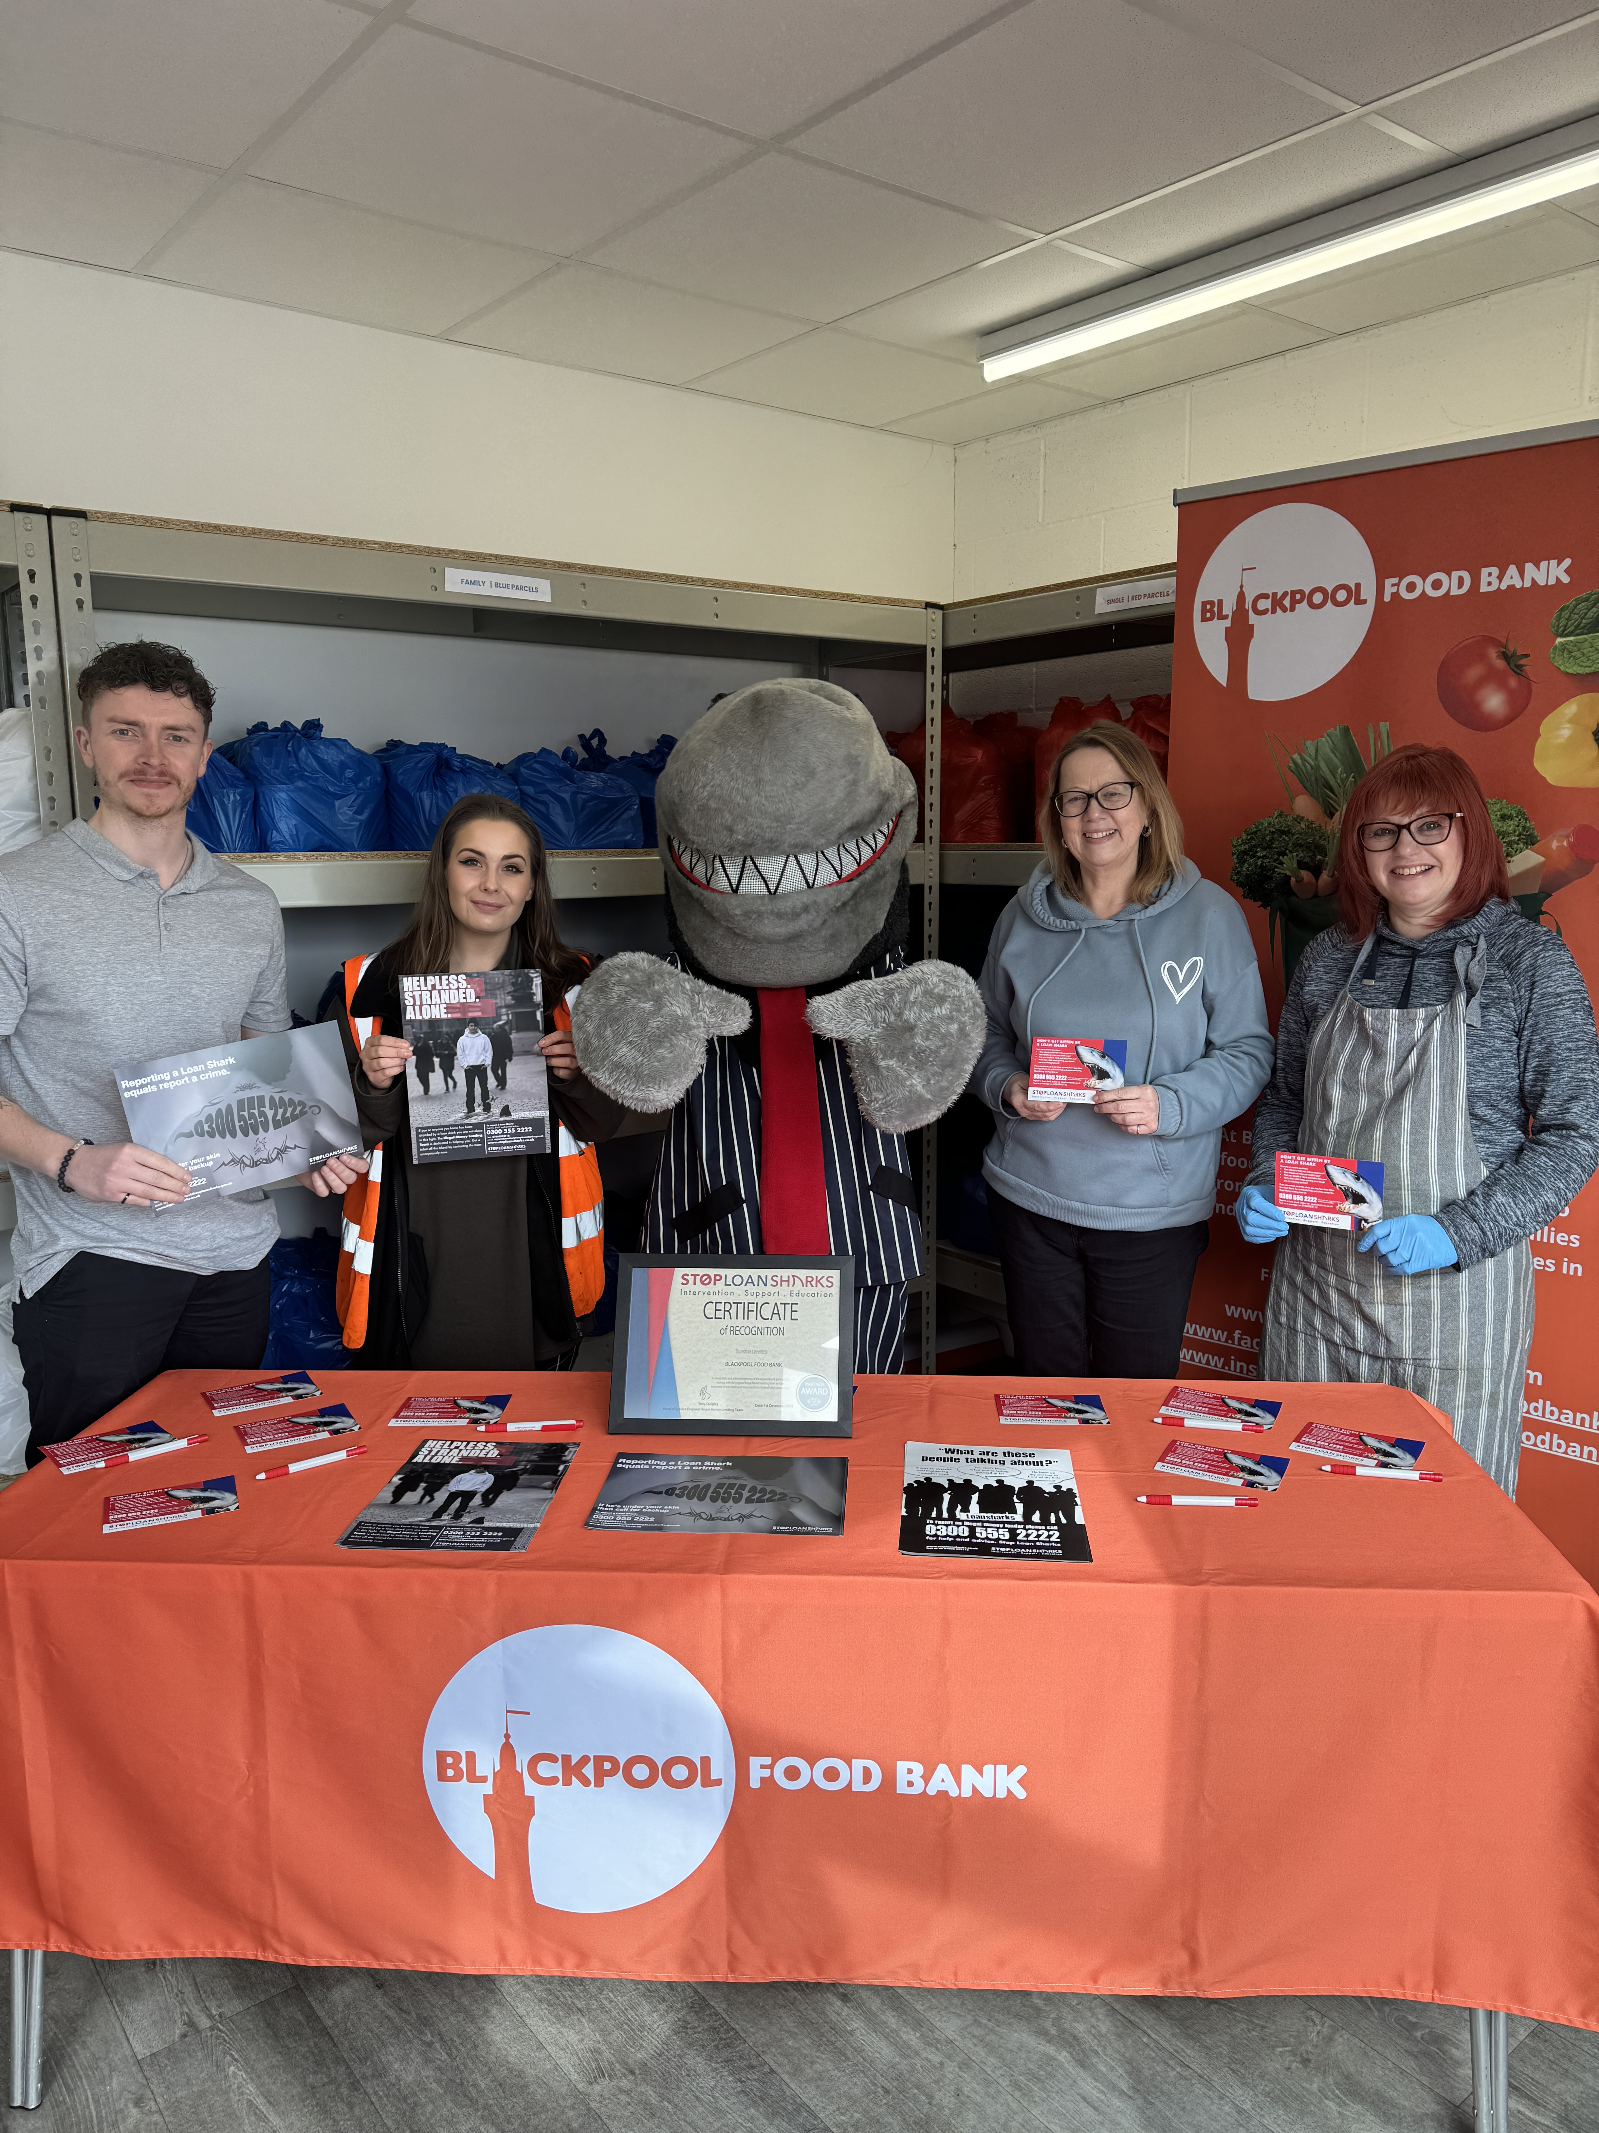
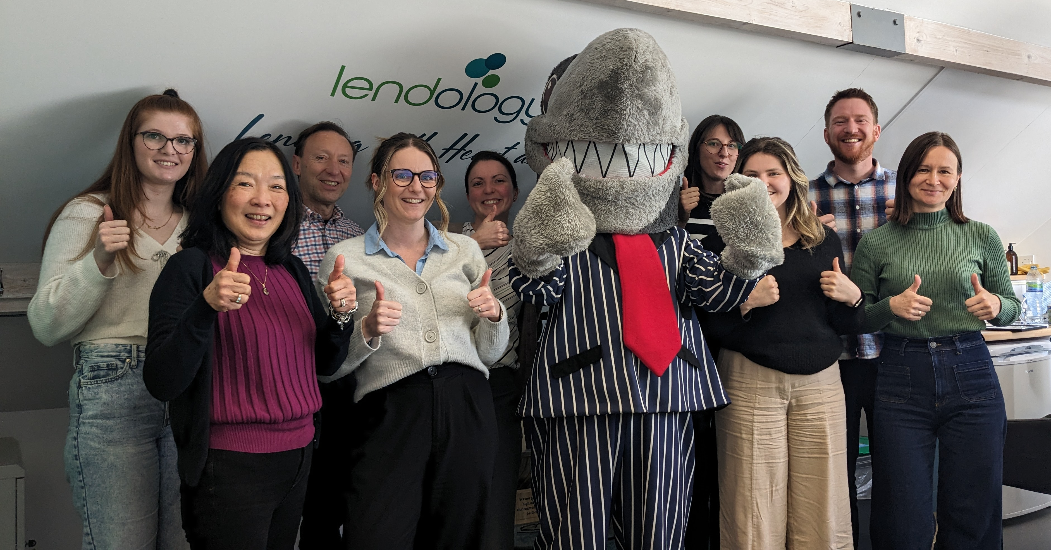

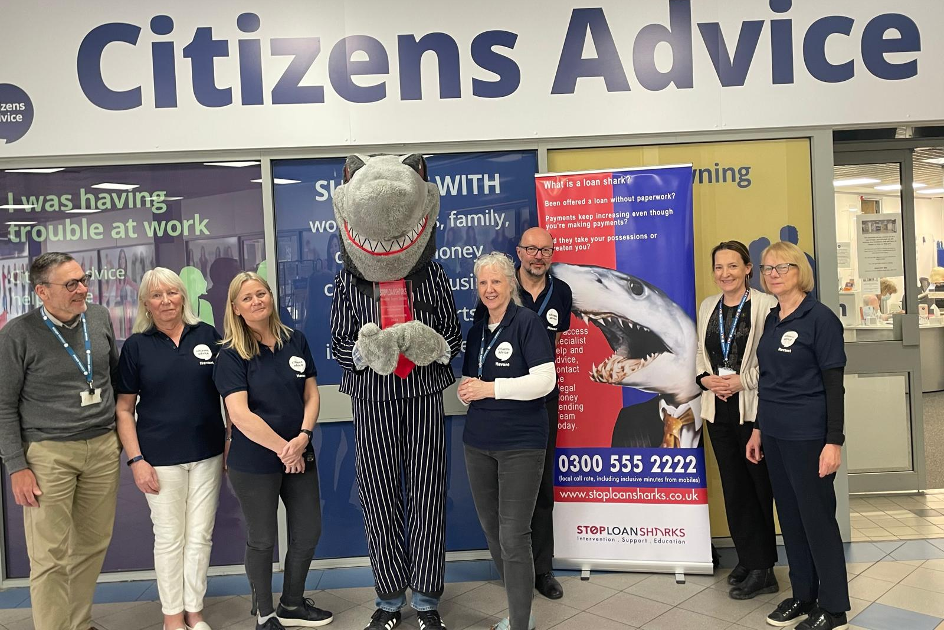

Congratulations! New partners join loan shark fight
Blackpool Food Bank
The Lendology team
Welcome aboard to all the organisations which have become official Stop Loan Sharks Partners in the past few months.
Citizens Advice Dudley & Wolverhampton, Money Wellness, Age UK Lincoln & South Lincolnshire, Wessex Water, Seetec Pluss, Blackpool Food Bank, Victim Support, Midland Heart, Lendology, Moneyline, Redcar and Cleveland Borough Council, Multiply Wiltshire, Victim Lincs and SOFEA are all among the organisations that have received Partner Recognition awards since our last newsletter. Citizens Advice Havant received the Partner Plus Award, making it the first Citizens Advice branch to win that level of award.
We are so grateful to the new organisations that have joined us and look forward to continuing to work closely with them. A big thank you also goes to all our existing partners who work so hard to help us tackle illegal money lending in our communities.
The team at Citizens Advice Havant
If you’d like to find out more about becoming an official partner visit www.stoploansharks.co.uk/partner-recognition-programme
Our work with CDFIs
Part of our work is to raise awareness about the options available to those who need to borrow, but don’t have access to credit through mainstream sources.
One of these options is credit unions, but there are also a host of CDFIs – Community Development Finance Institutions – that offer a lifeline for someone looking to borrow safely. They are often community based, and can get finance to people, businesses and social enterprises that may have struggled to get it elsewhere.
Stop Loan Sharks works closely with Responsible Finance which is the national membership body for these finance
providers. If you are looking to borrow, but are struggling through the banks or choosing not to go to mainstream lenders, you can find CDFIs through the Responsible Finance website. If you are involved with a CDFI and want to find out more about working with Stop Loan Sharks, or would like to organise free training in how to spot the signs of illegal lending, send an email to: catherine.wohlers@birmingham.gov.uk

Slide 4
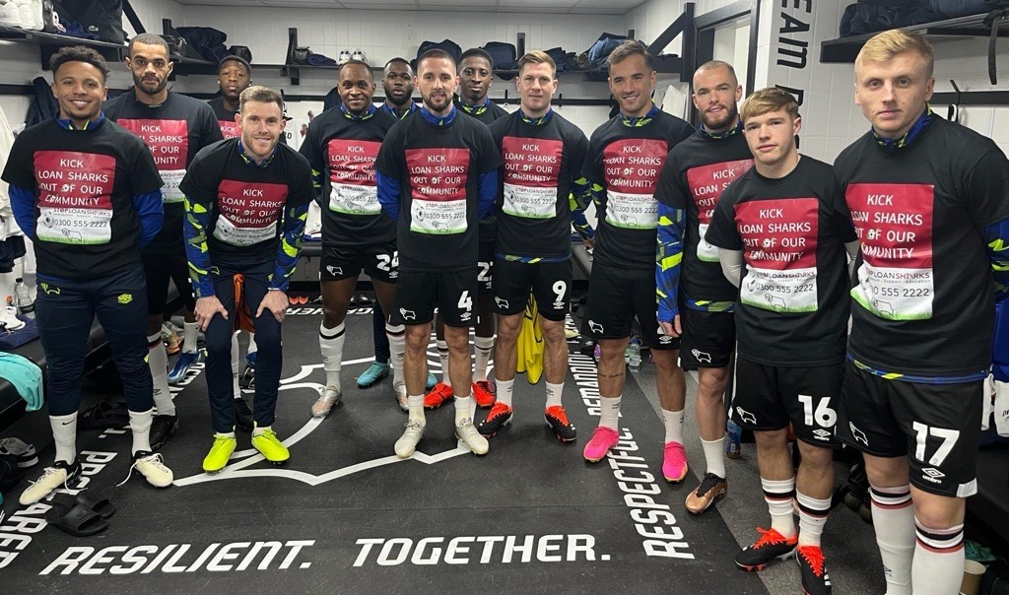
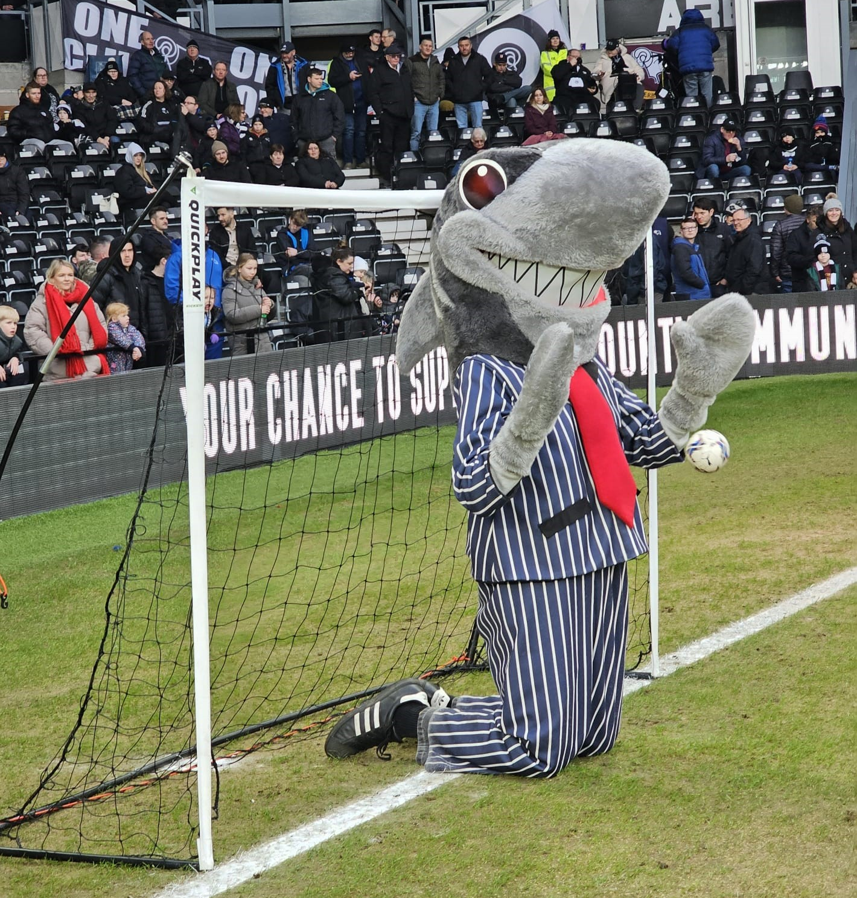
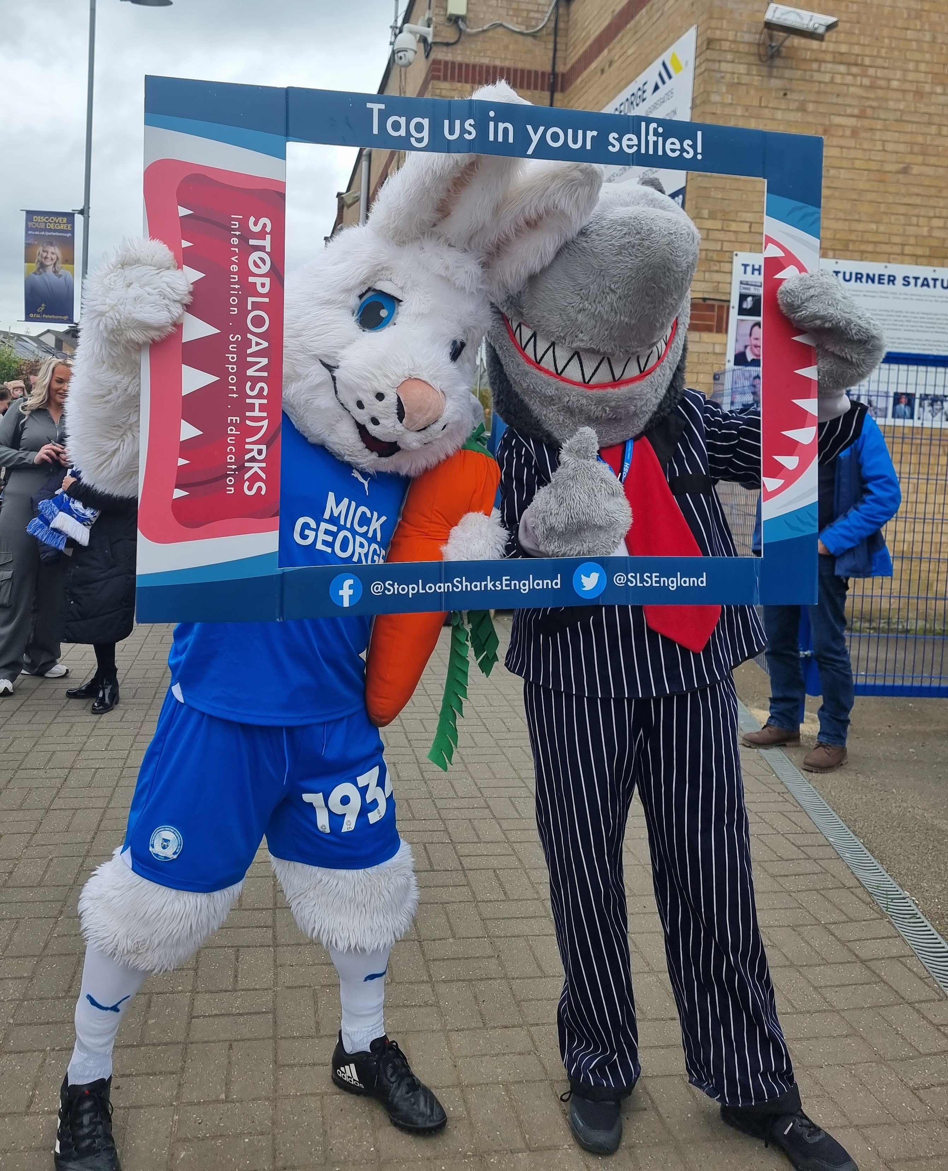
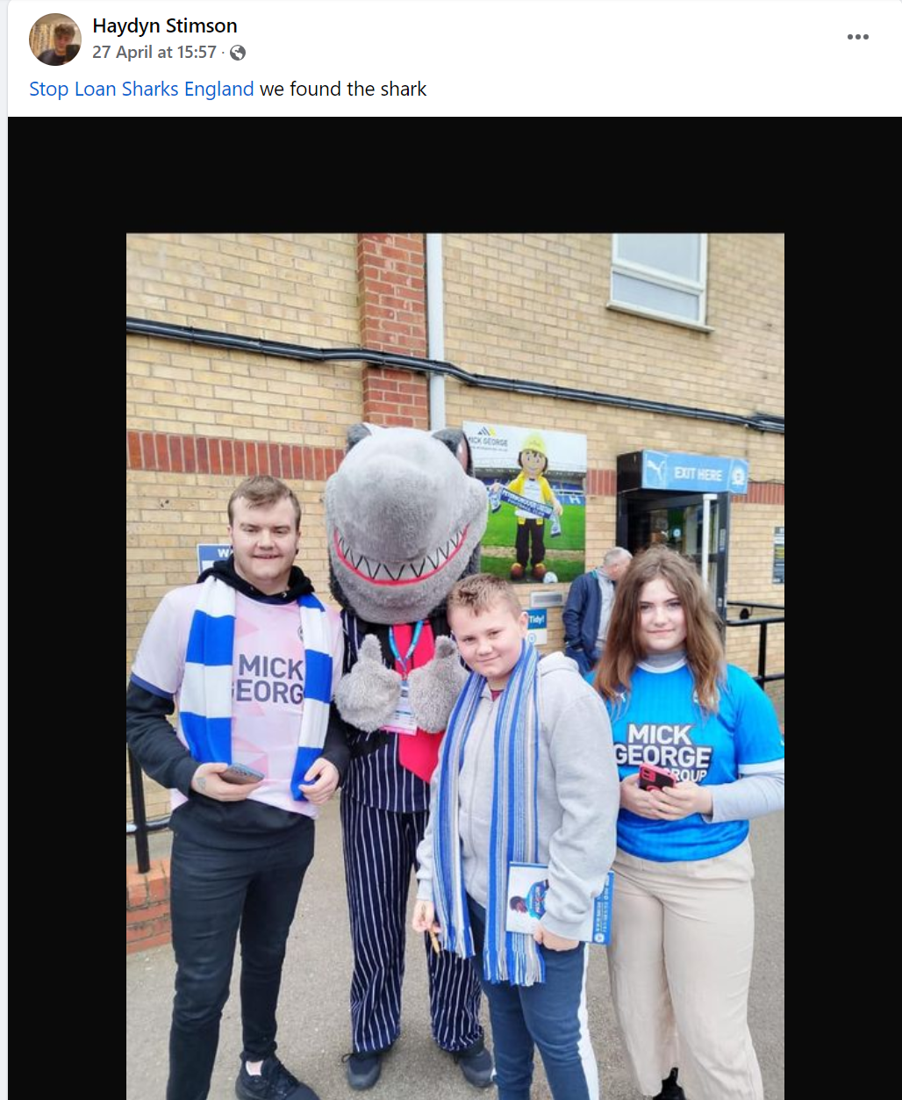
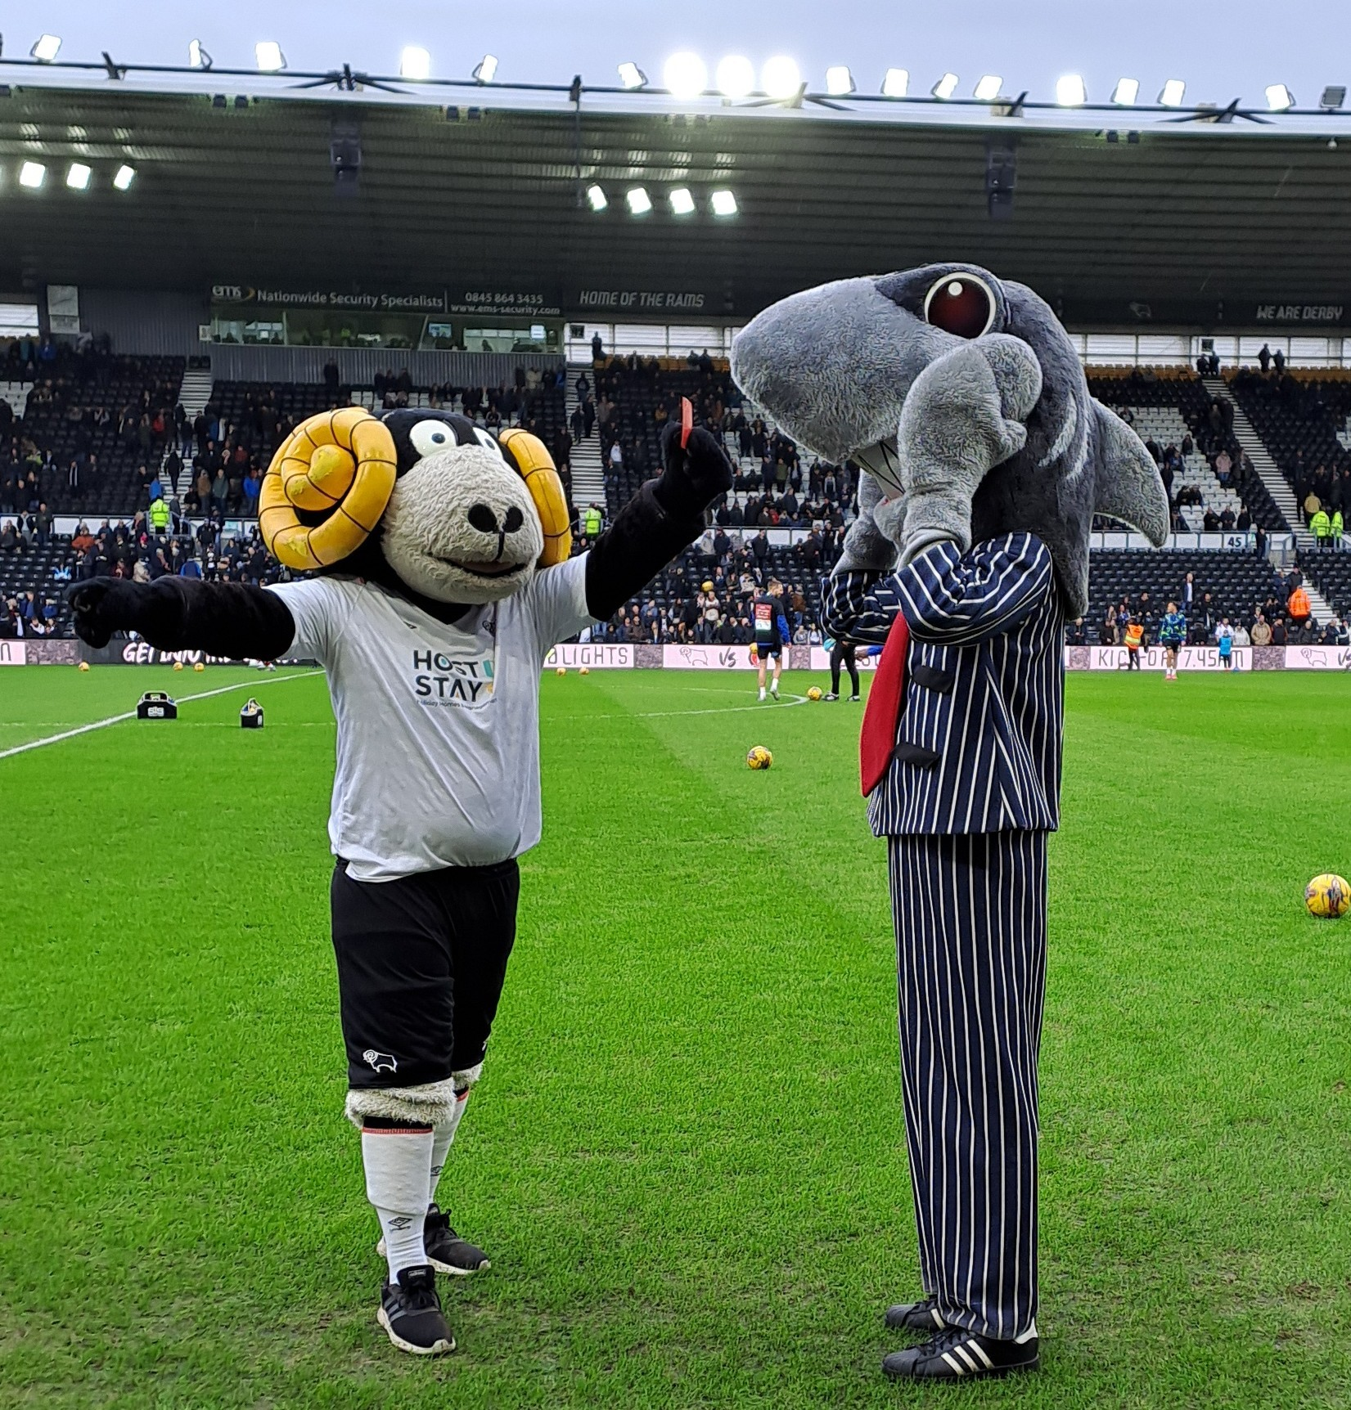
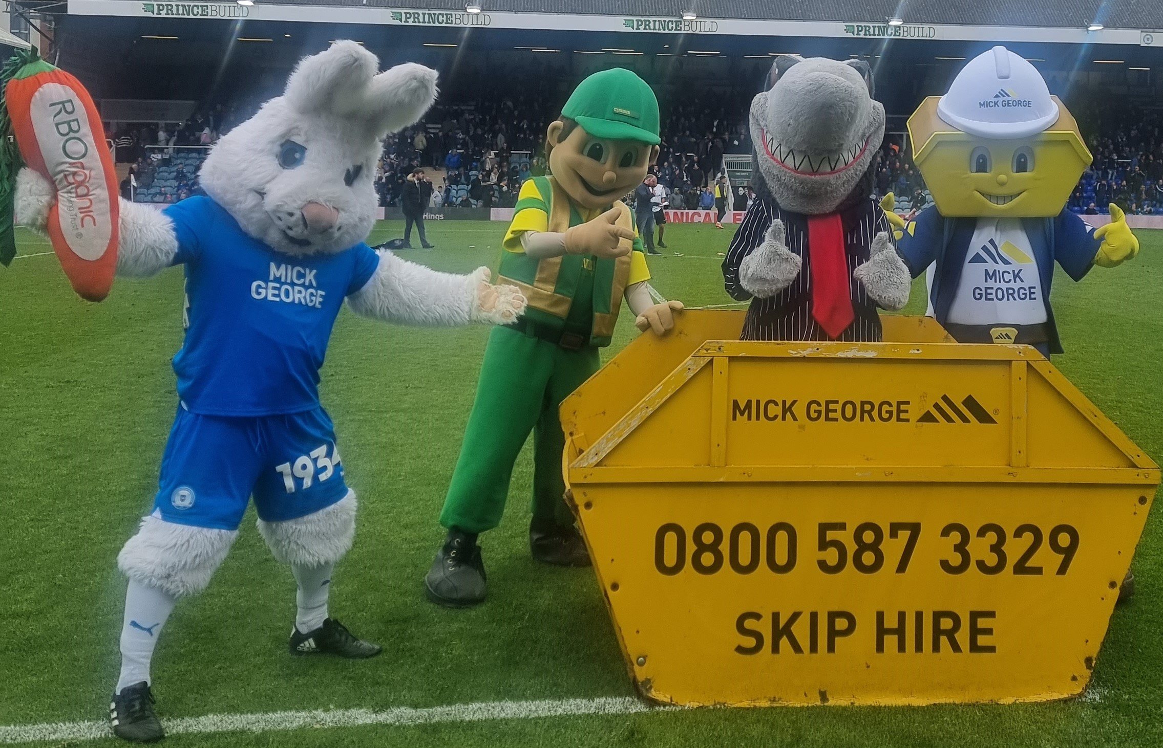
Football clubs unite to show
loan sharks the red card!
Two major football clubs pitched in to help in the fight against loan sharks this year.
Derby County and Peterborough United both welcomed the Stop Loan Sharks team to their grounds on busy match days.
The players all took time to spread the Stop Loan Sharks message, posing for photos and wearing specially designed t-shirts during their warm-ups. They even signed a couple of t-shirts for lucky fans to win.
Supporters loved grabbing a selfie with a 6ft shark as well as the traditional club mascots and shared their pics online.
At Derby, Sid was invited onto the pitch at half-time and put through his paces in goal. He was later shown the red card by official club mascot Rammie. At Peterborough, the other mascots were not too pleased about having a loan shark in their midst and put him in his place – a skip!
The Derby County players wearing the Stop Loan Sharks t-shirts
hg
Thanks to the clubs who invited us along, the supporters who took time to post pictures, and the players, who, despite the pressures of a big match day, were still able to help spread the word about Stop Loan Sharks.
Haydyn Stimson won a signed t-shirt
‘Safe hands’ Sid in goal at Derby
Peter Burrow meets Sharky
Rammie shows Sid the red card
Mascots at Peterborough put Sharky in the sin bn

Slide 5
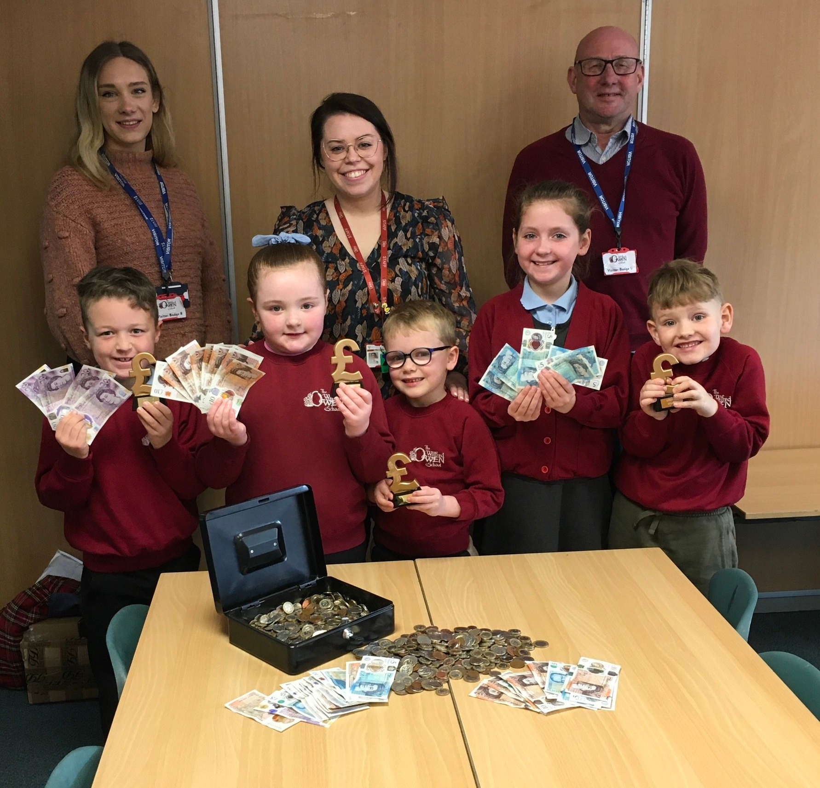
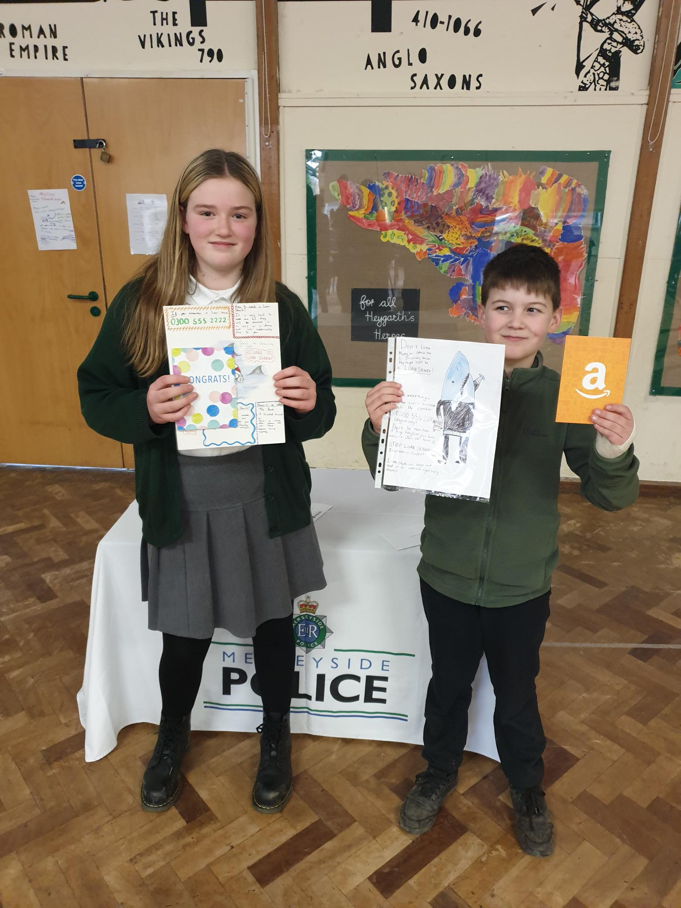
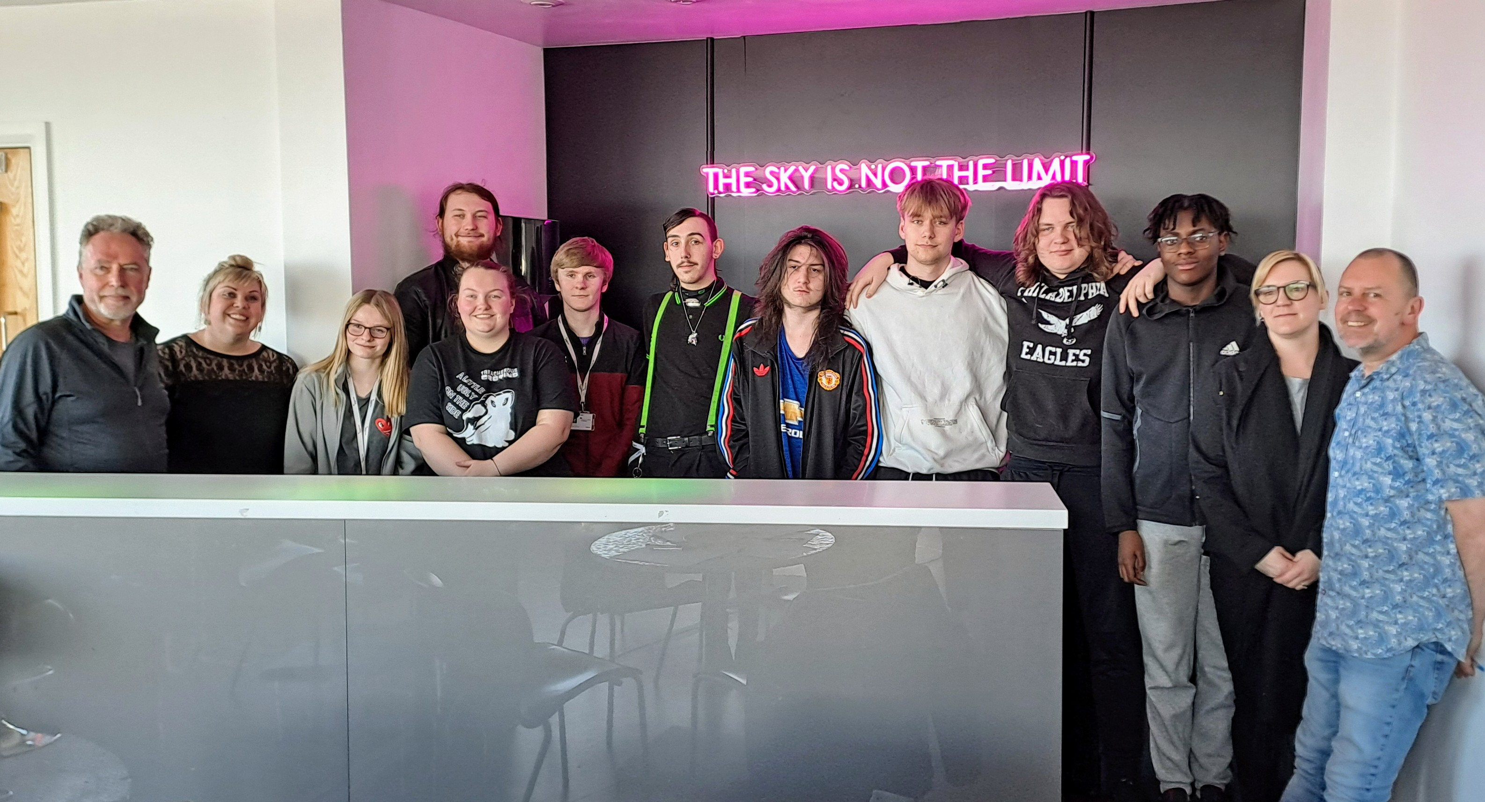
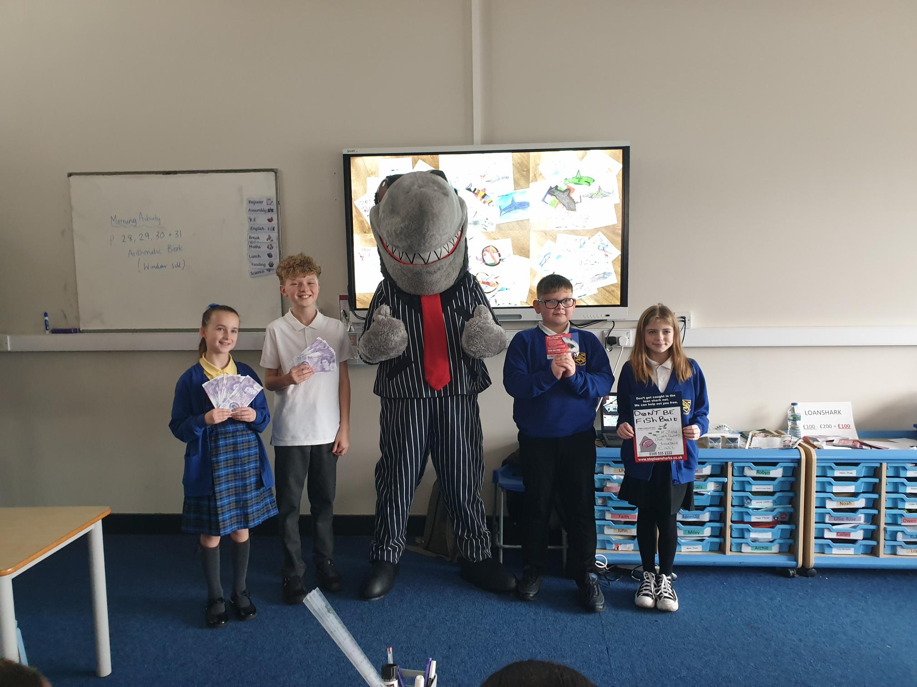
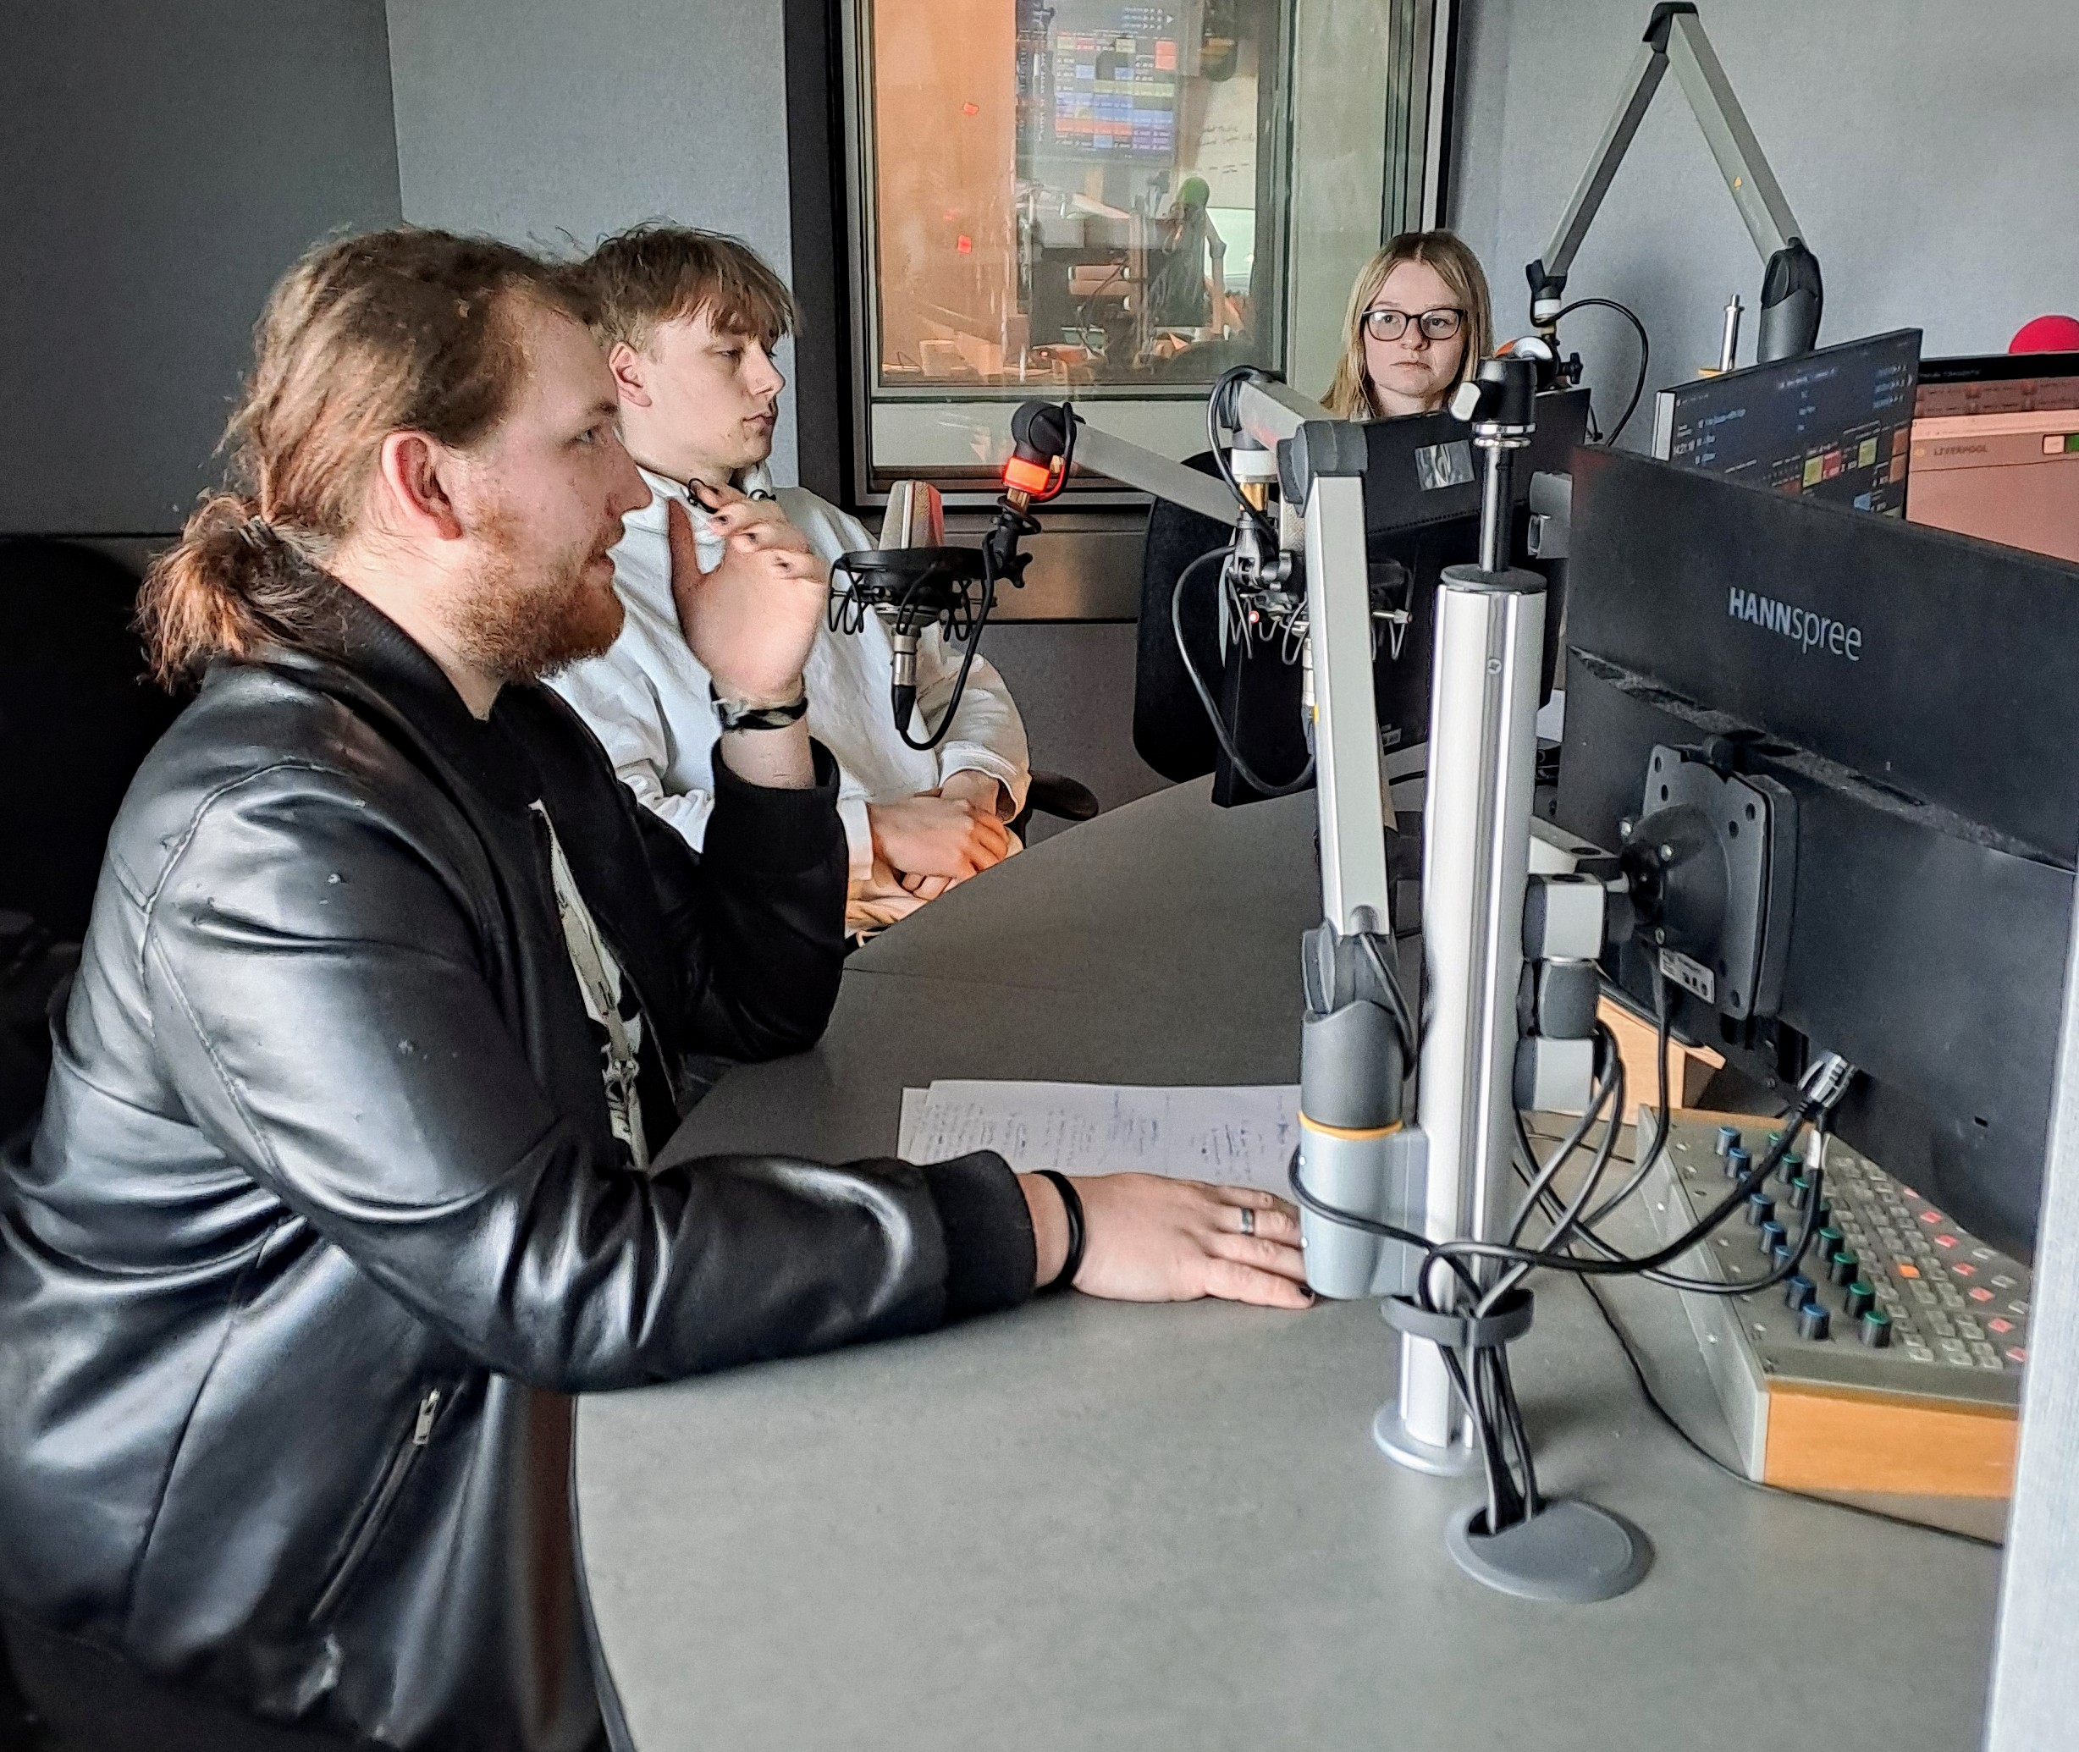
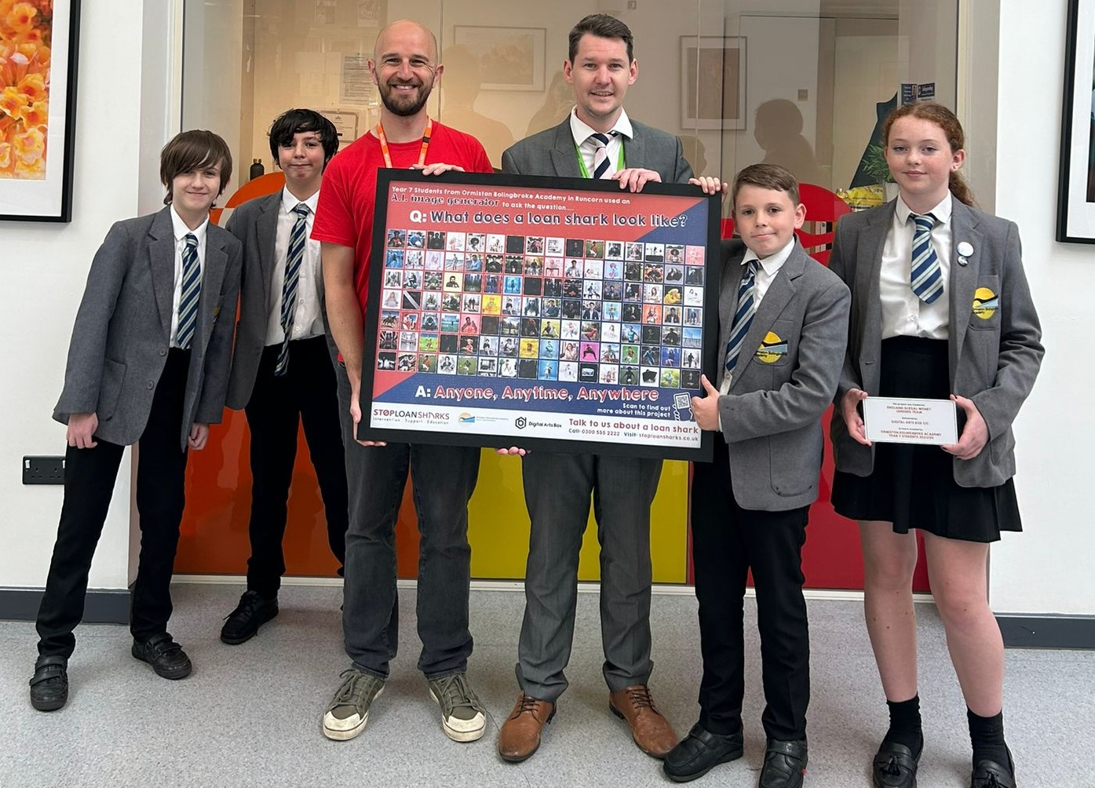
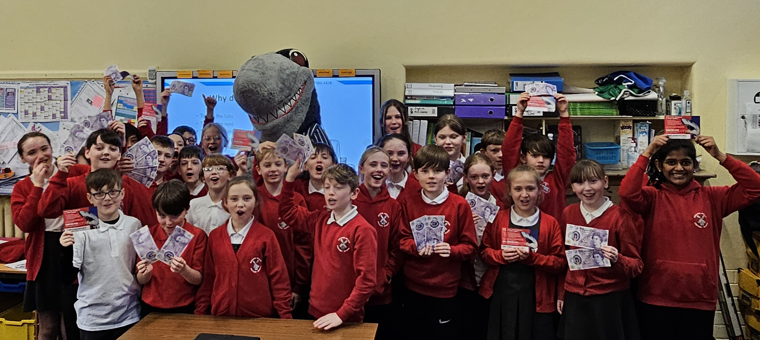
Creativity is key in tackling the loan sharks
hg
Wilfred Owen School
We continue to be blown away by the imagination and creativity of students in our schools and colleges as they help us and our partners in the fight against loan sharks. Here are just a few of the activities that have been going on this year.
We have continued our work with schools in the Wirral area working with Merseyside Police on the Pathfinders Project. That has seen youngsters design posters and learn all about the dangers of illegal money lenders.
In Runcorn, Digital Arts Box delivered a brilliant project at Ormiston Bolingbroke Academy using money confiscated from loan sharks. Pupils there used AI to produce an eye-catching rogues’ gallery of the many different faces of loan sharks.
In Shropshire, young entrepreneurs at Wilfred Owen Primary School turned £200 into an incredible £1,267.51 in just five weeks as part of a project with Just Credit Union.
And in Liverpool, students from St Helens College spent the day at Radio City Tower in Liverpool working with experts from Bauer Media to produce hard-hitting radio ads raising awareness of credit unions.
The AI artwork produced by pupils at Ormiston Bolingbroke Academy
St Helens College students
Cathcart Street Primary
Recording the radio ads
Our Lady and St Edwards School
Ormiston Bolingbroke Academy
Bidston Avenue Primary School pupils

Slide 6
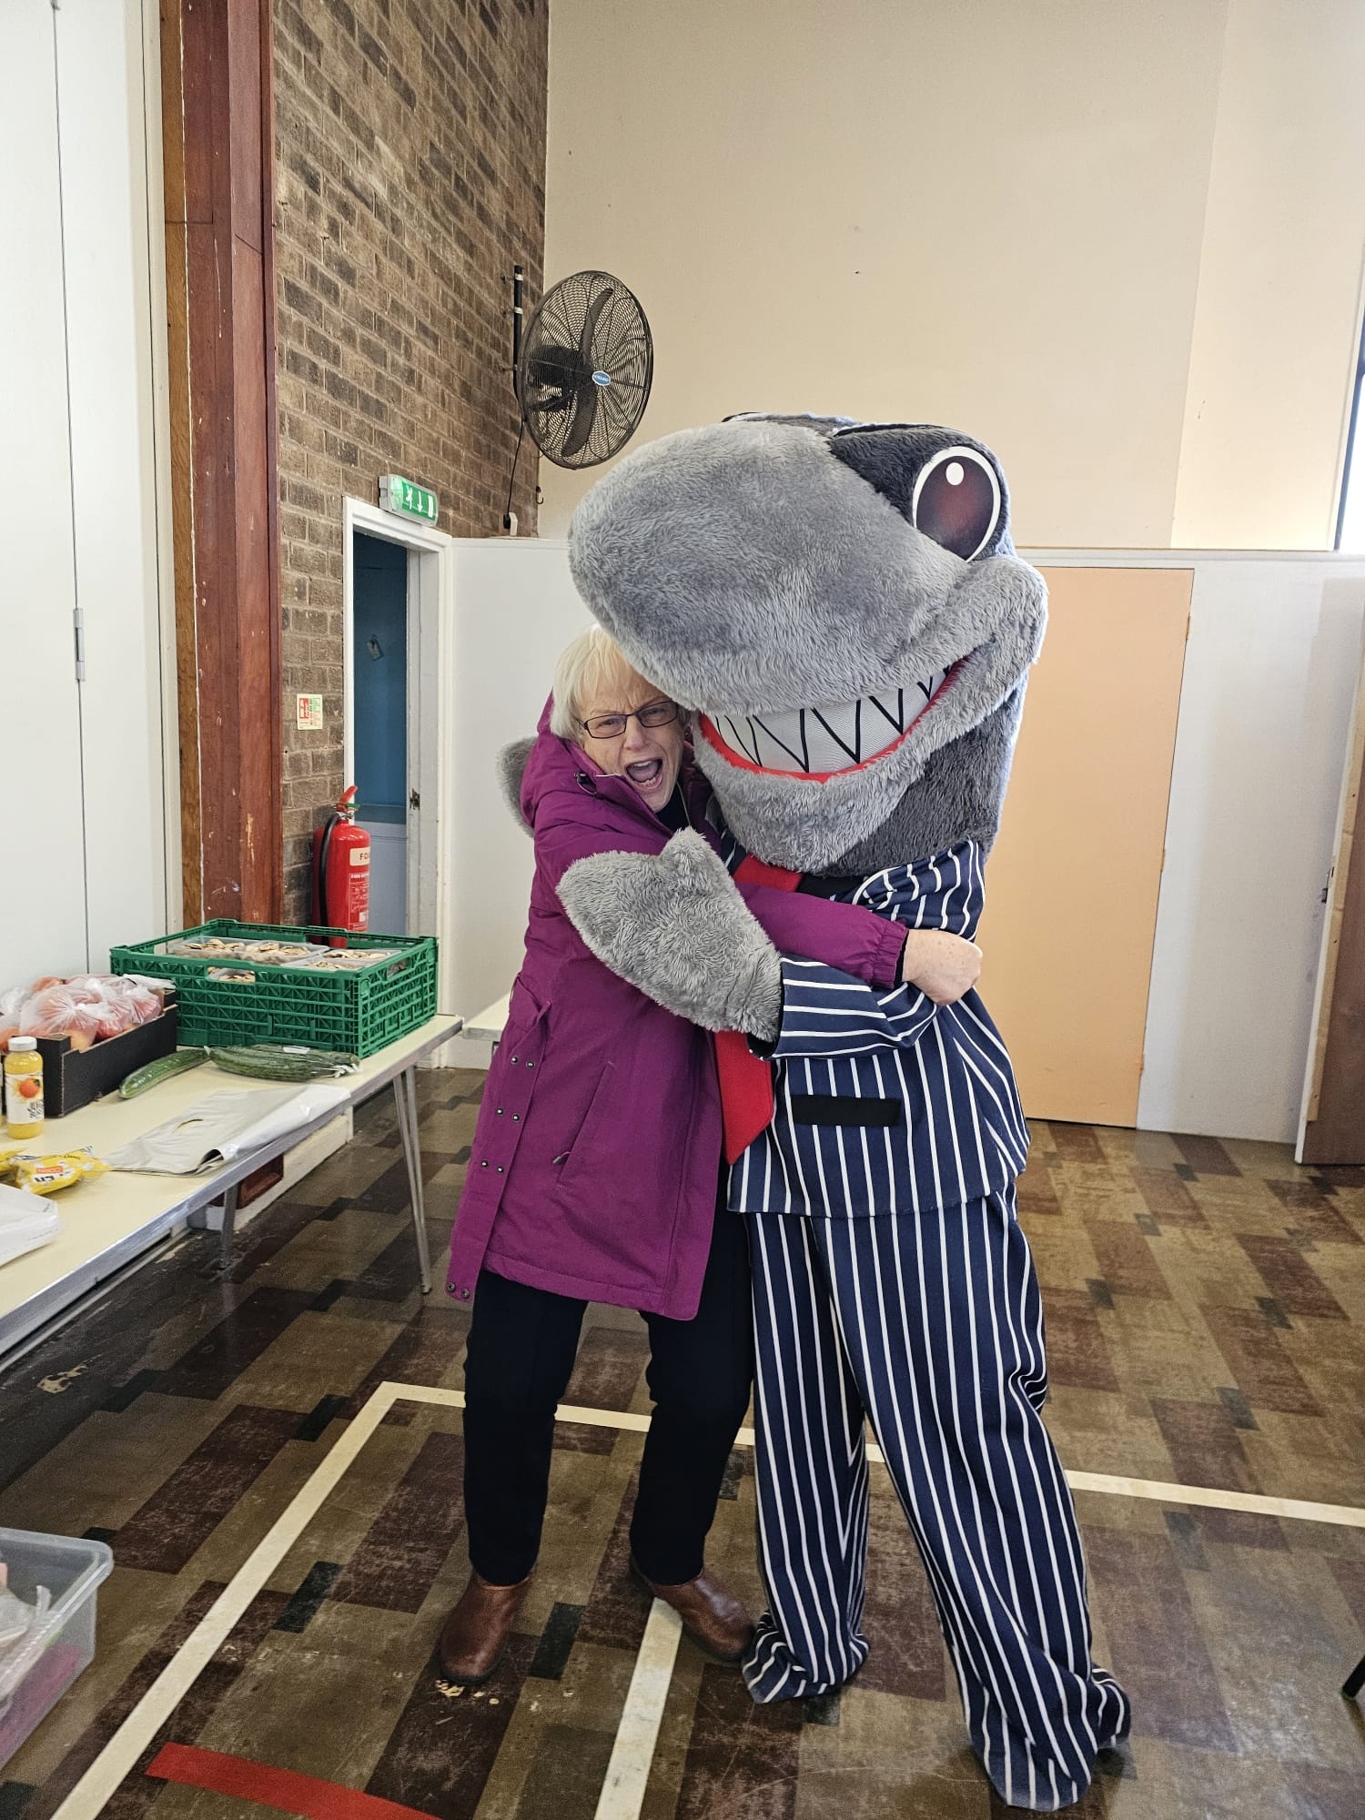
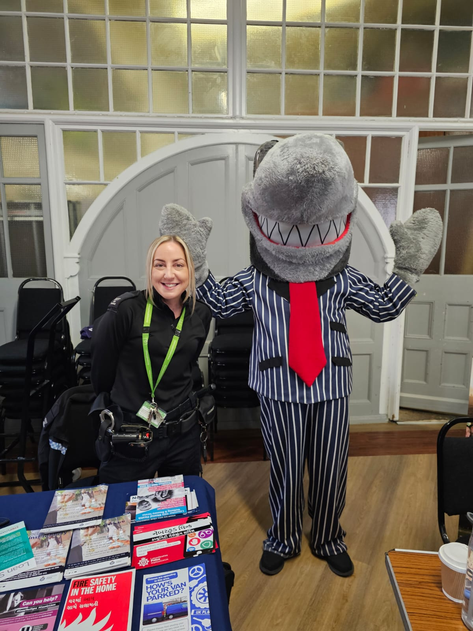
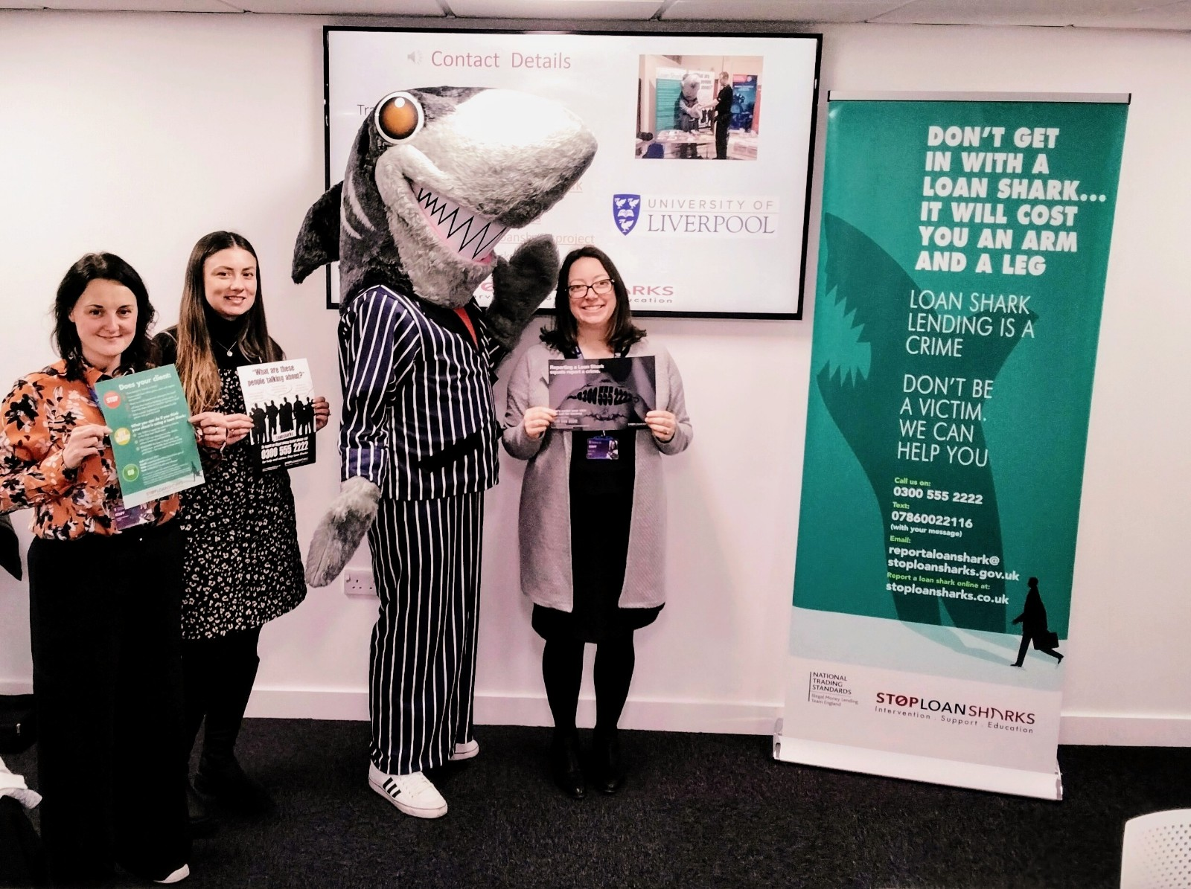
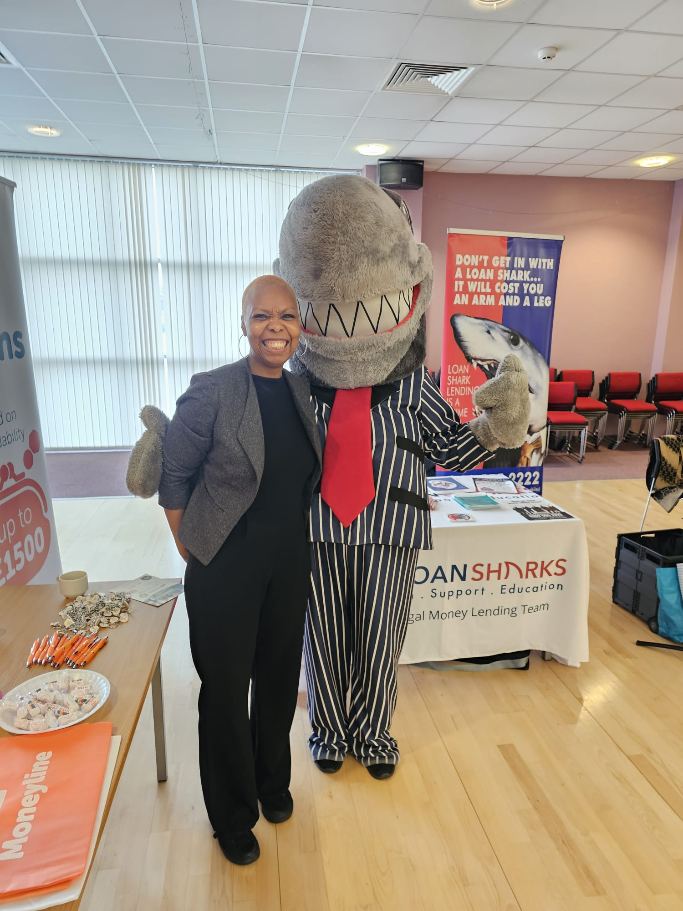
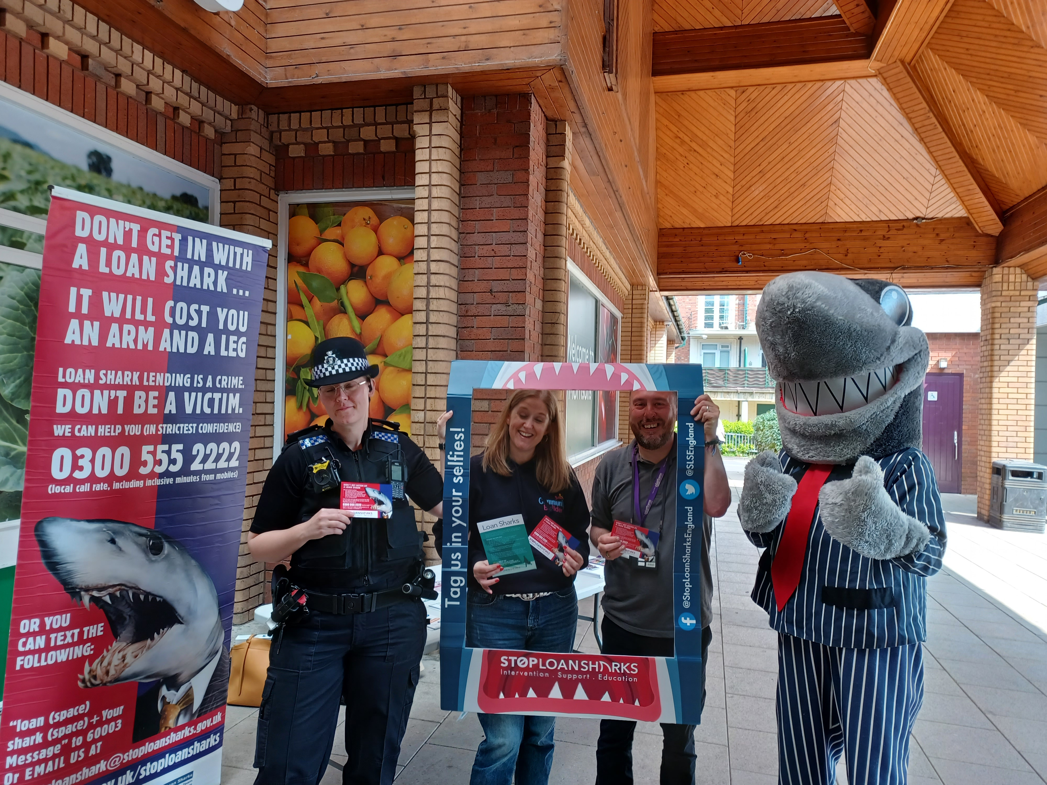
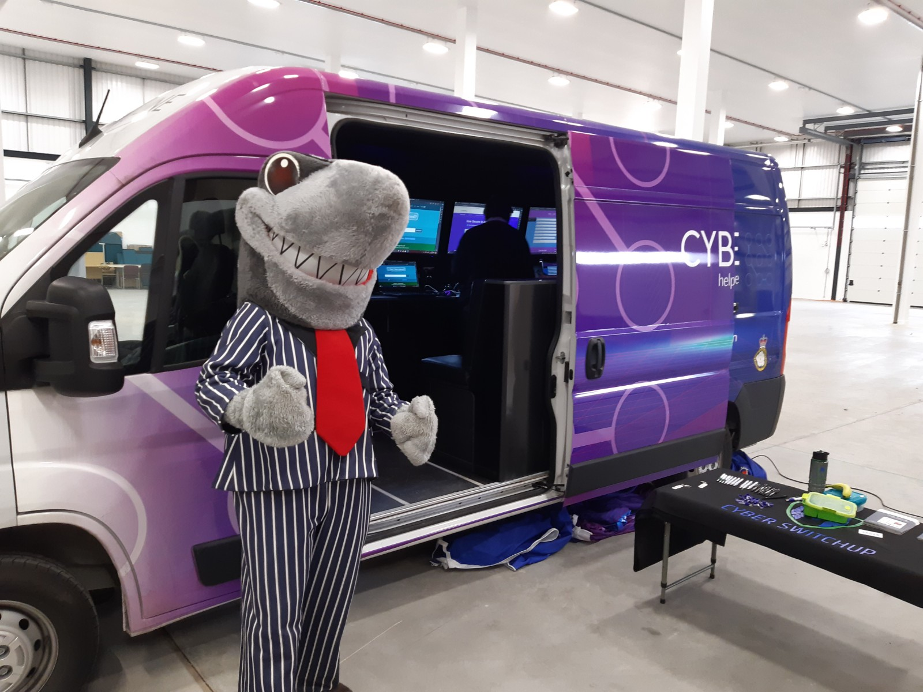
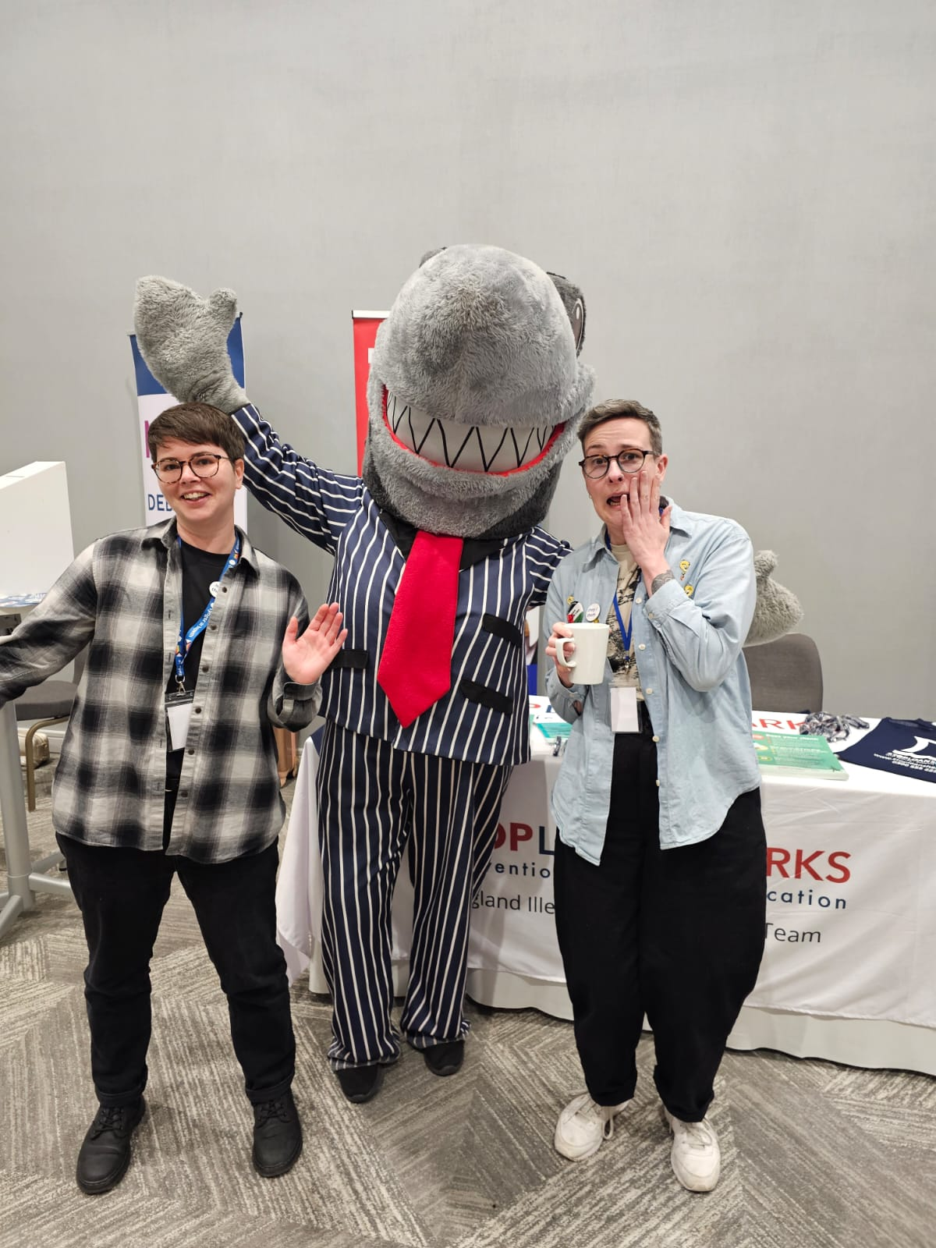
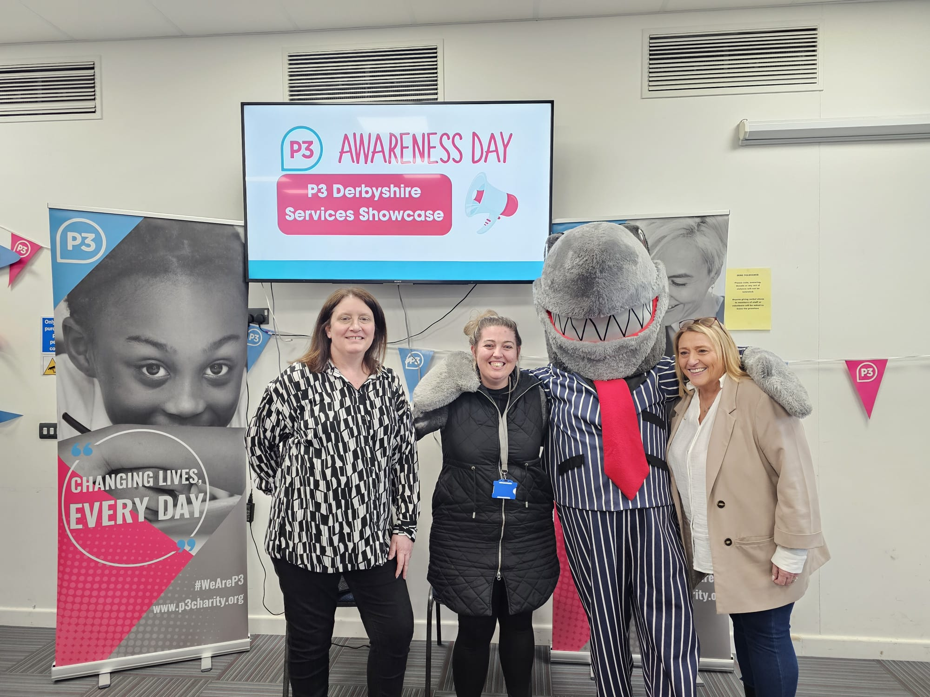
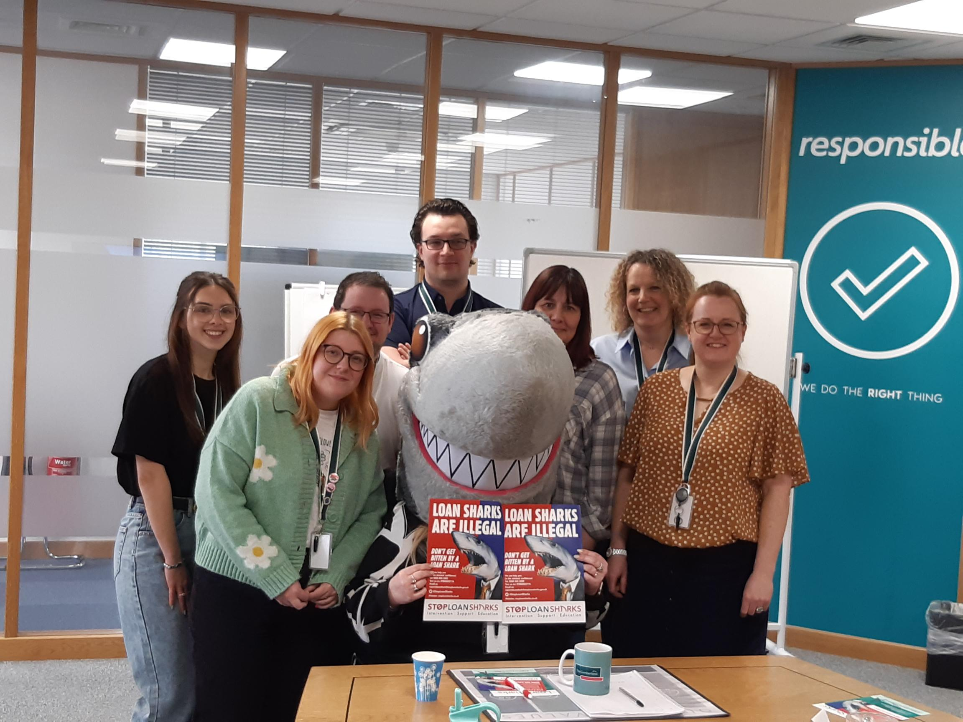
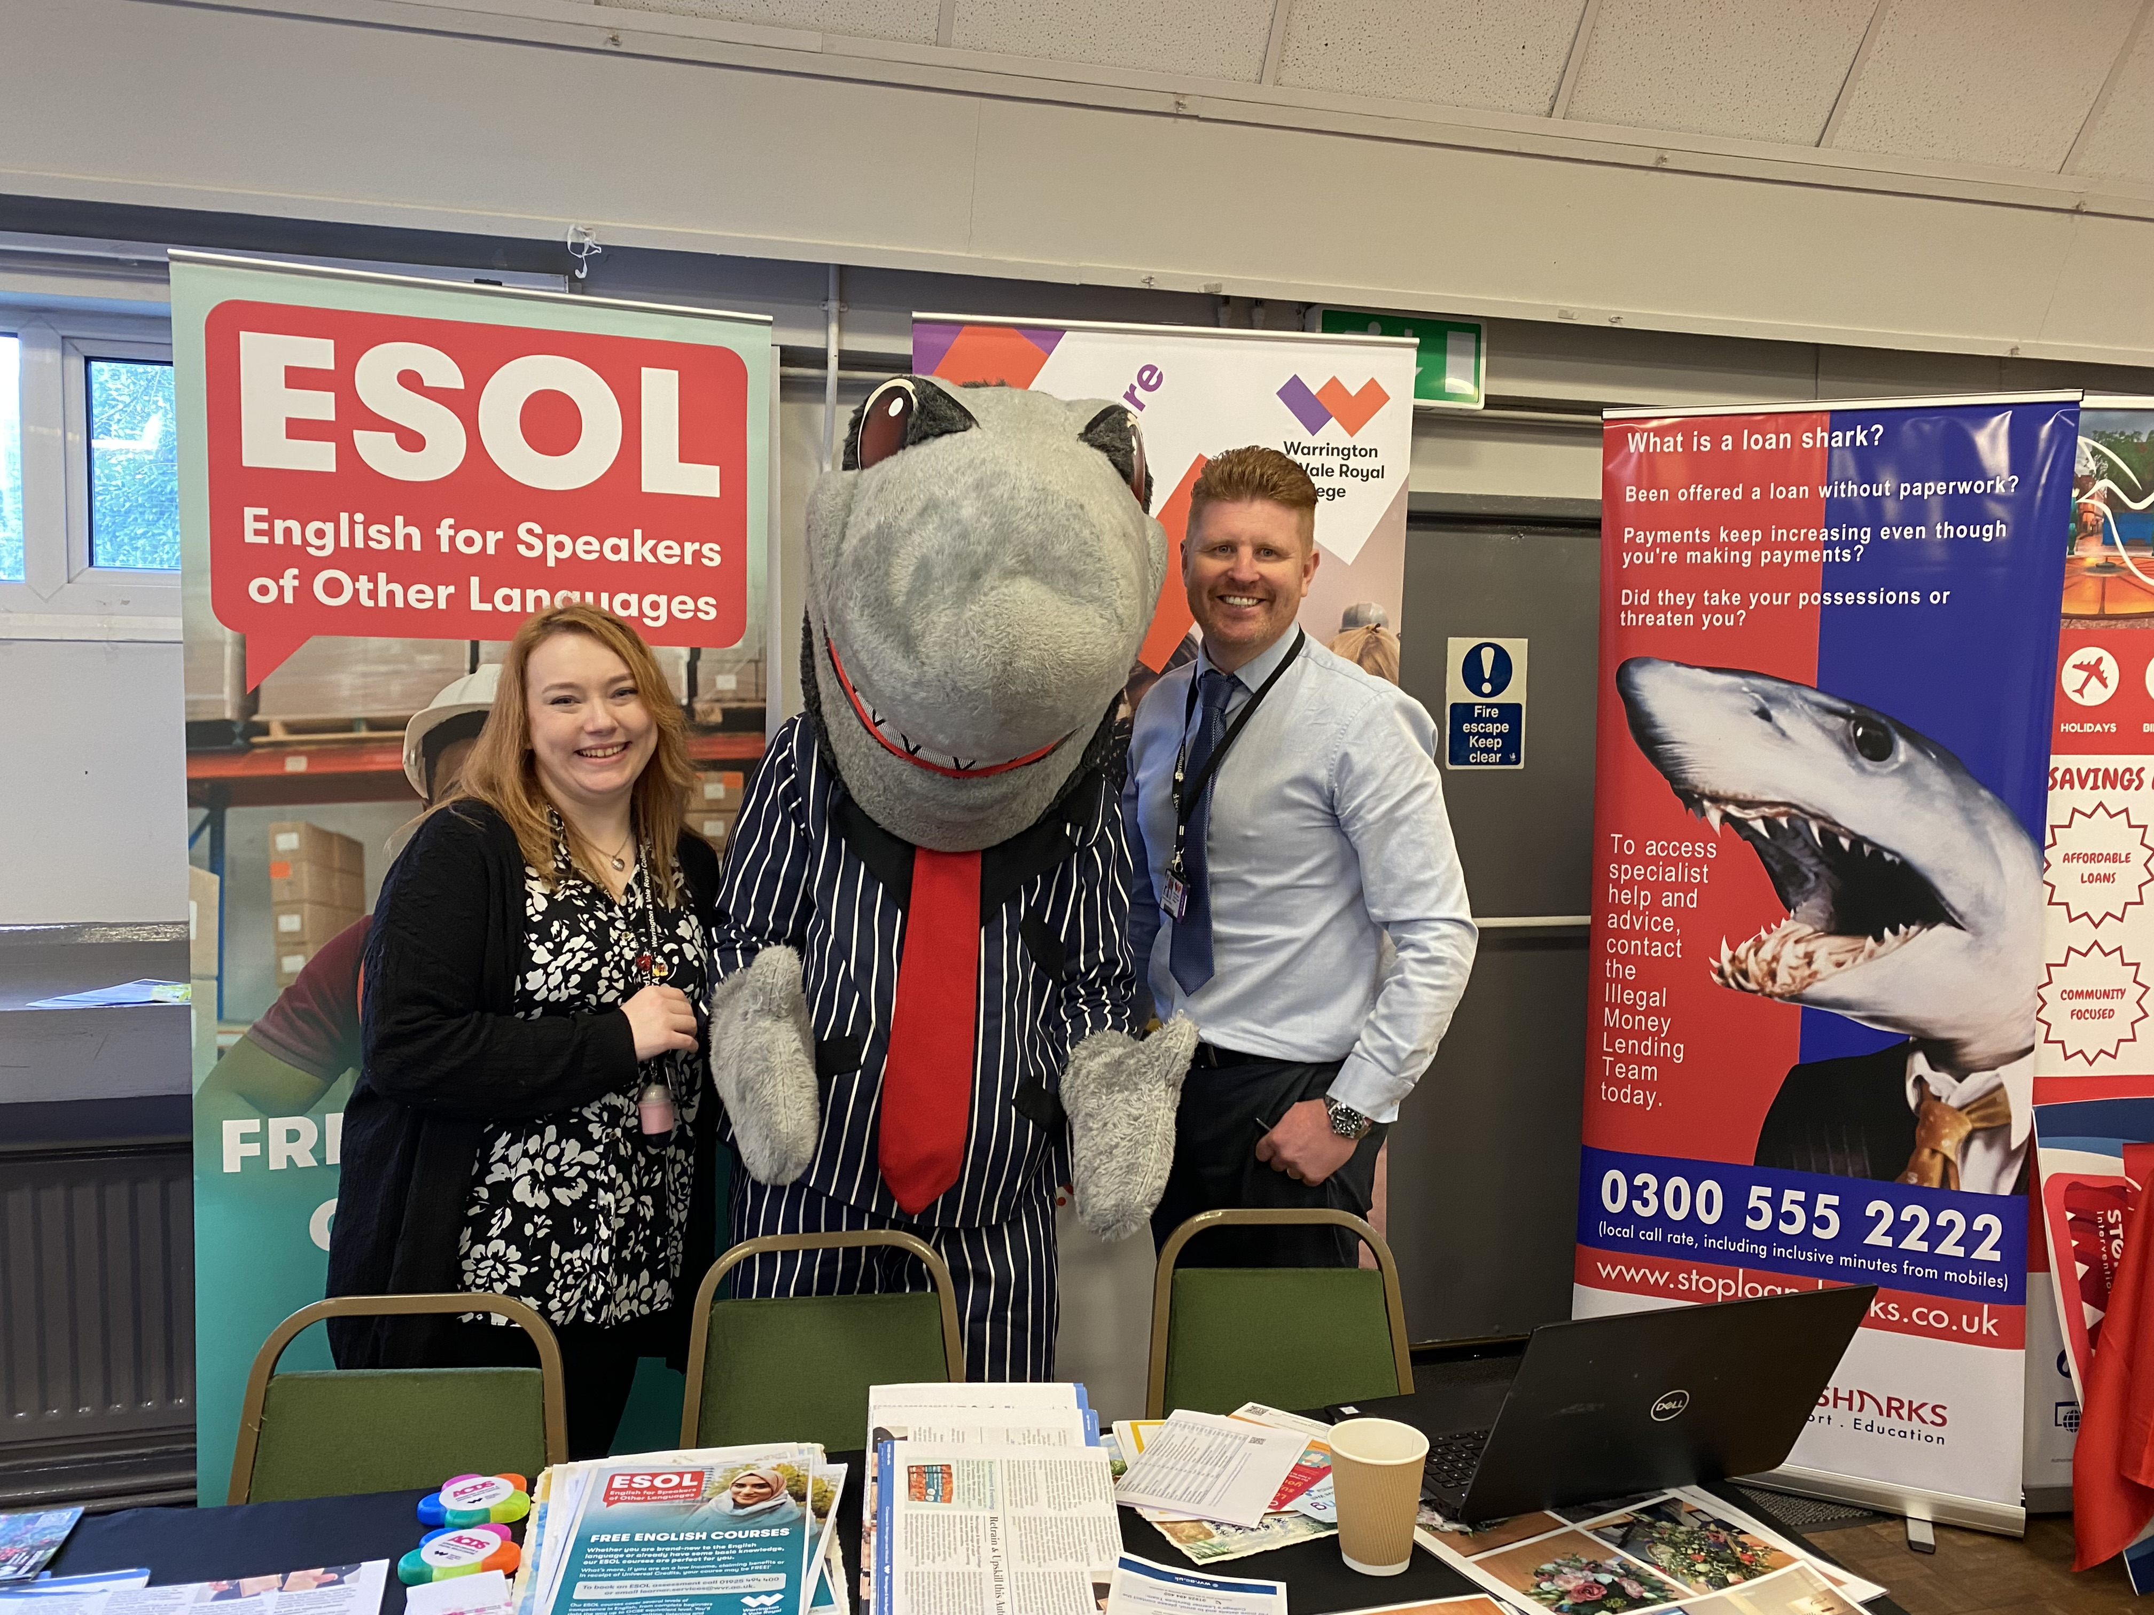
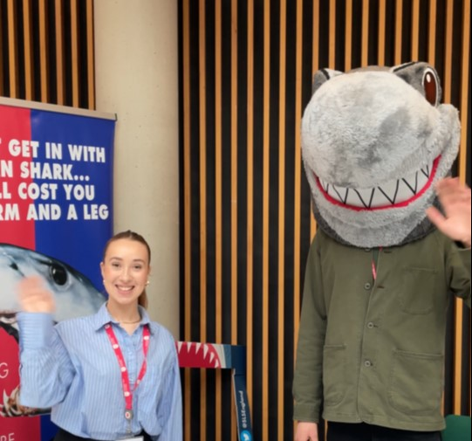
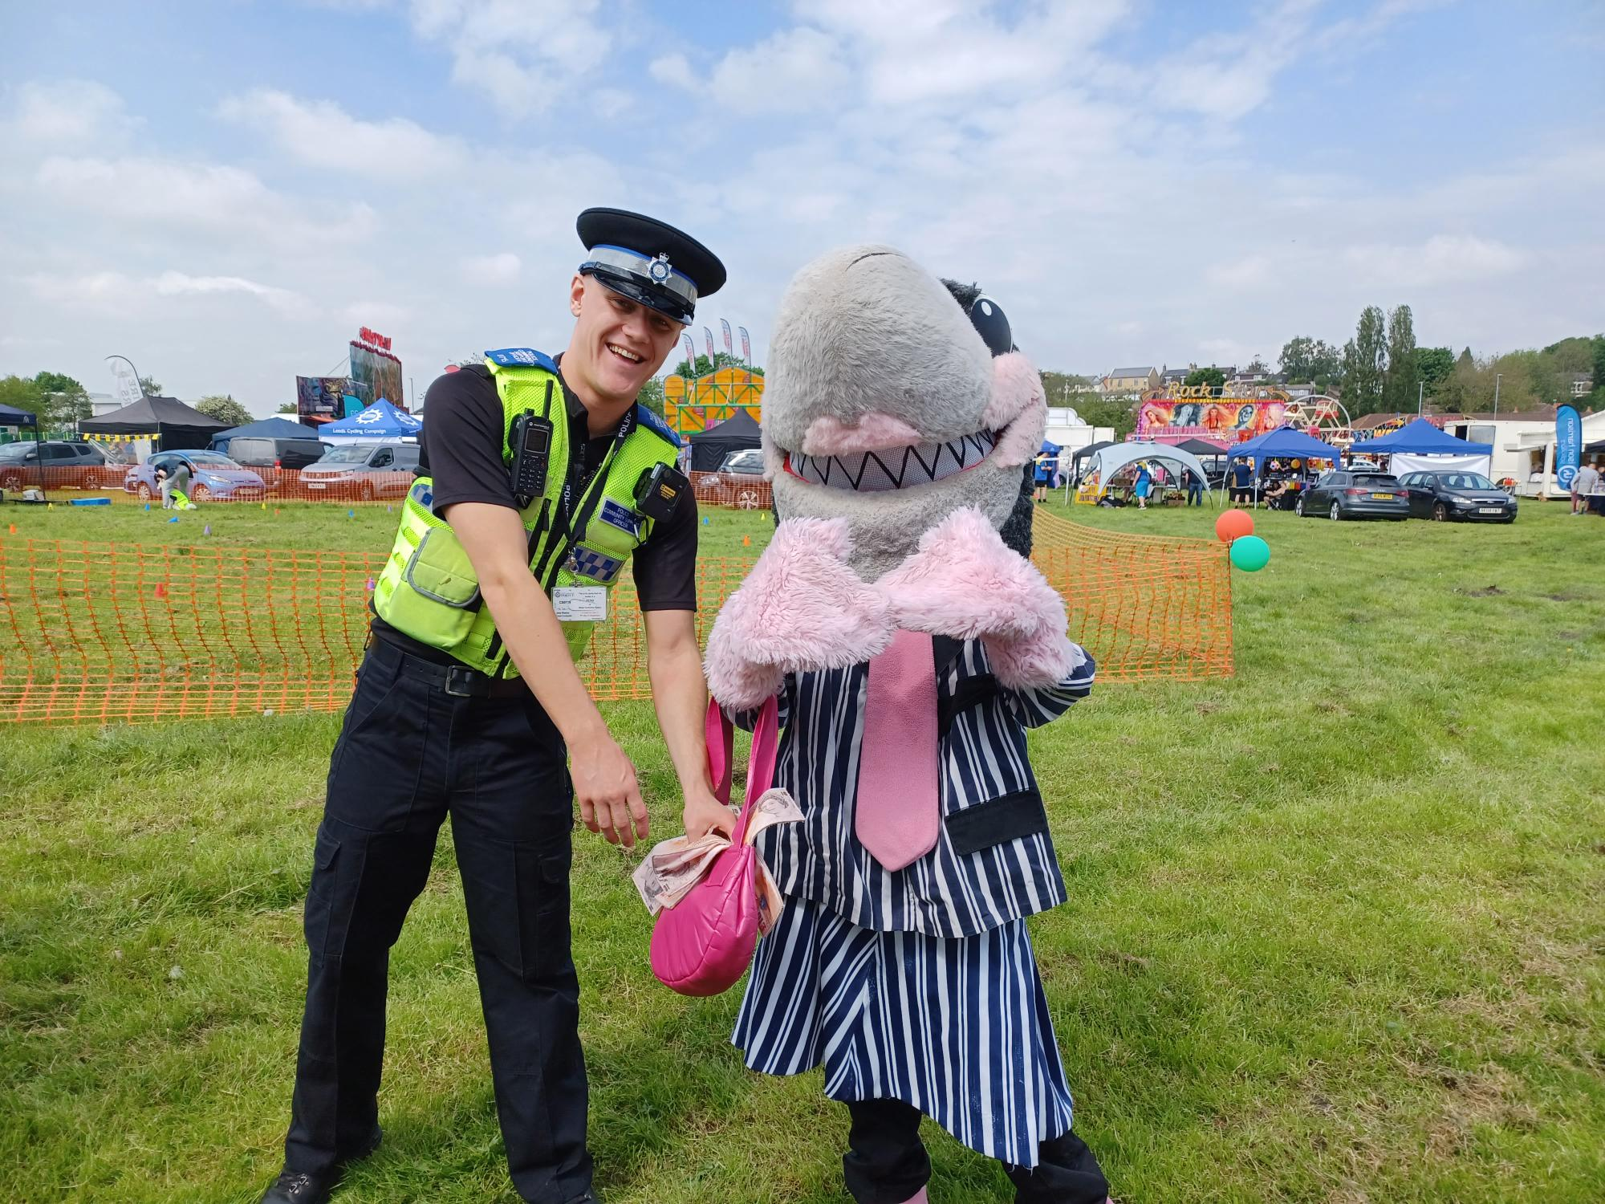
Sid’s Selfies – have you been snapped?

Slide 7

Arrests
January – June 2024
Bury
1 arrest
Leeds
1 arrest
Salford
2 arrests
Barnsley
1 arrest
Wirral
2 warrants
2 arrests
Cambridgeshire
1 arrest
Crewe
1 arrest
Cwmbran
1 arrest
Surrey
1 arrest
Suffolk
1 arrest
Exeter
1 arrest
West London
1 arrest

Slide 8


Latest statistics
At least
31,742
845
At least
£91.3m
Arrests
People supported
Debt written off
421
605
1.08m
Number of prosecutions
Number of years in jail for loan sharks
Number of people in England borrowing from a loan shark
Thanks for your support in Stop Loan Sharks Week
Thanks to everyone who supported Stop Loan Sharks Week 2024.
We decided to bring the week forward this year to fit in between Easter and the schools break up and to avoid clashing with our 20th anniversary celebrations in September.
This year the week had the theme No Blame, No Shame. We wanted to get the message across that borrowers are in no way to blame when they take a loan from an illegal lender – they have been targeted by a criminal and the lender is to blame, not them. They should also not feel ashamed – sometimes a loan shark will threaten to expose their borrowing to their family members or colleagues, preying on feelings of guilt and responsibility, but they have nothing to worry about with us. We are here to help, not judge.
The campaign appeared to strike a chord with many partner organisations, with at least 520 downloading our social media toolkit and sharing posts online. Many also used our specially-themed blog for newsletters and websites to make sure the message reached clients who may be at risk. We have worked out that our reach was around 442,595 – which is incredible. Thanks again to everyone who got involved - watch this space for more content to come to mark the 20th anniversary of Stop Loan Sharks later this year.
Got information about loan sharks? Email us 📧 0300 555 2222 ☎️

Slide 9
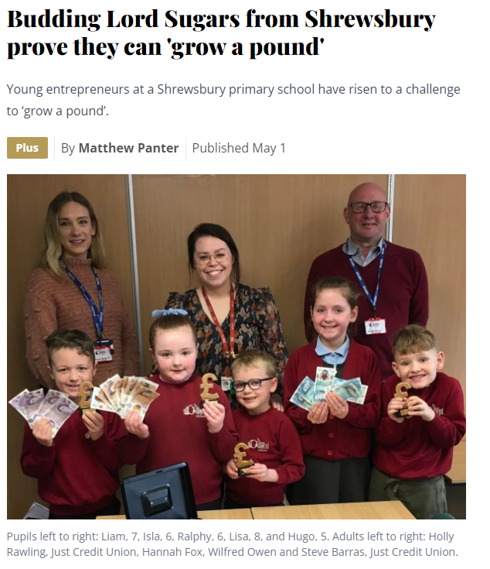

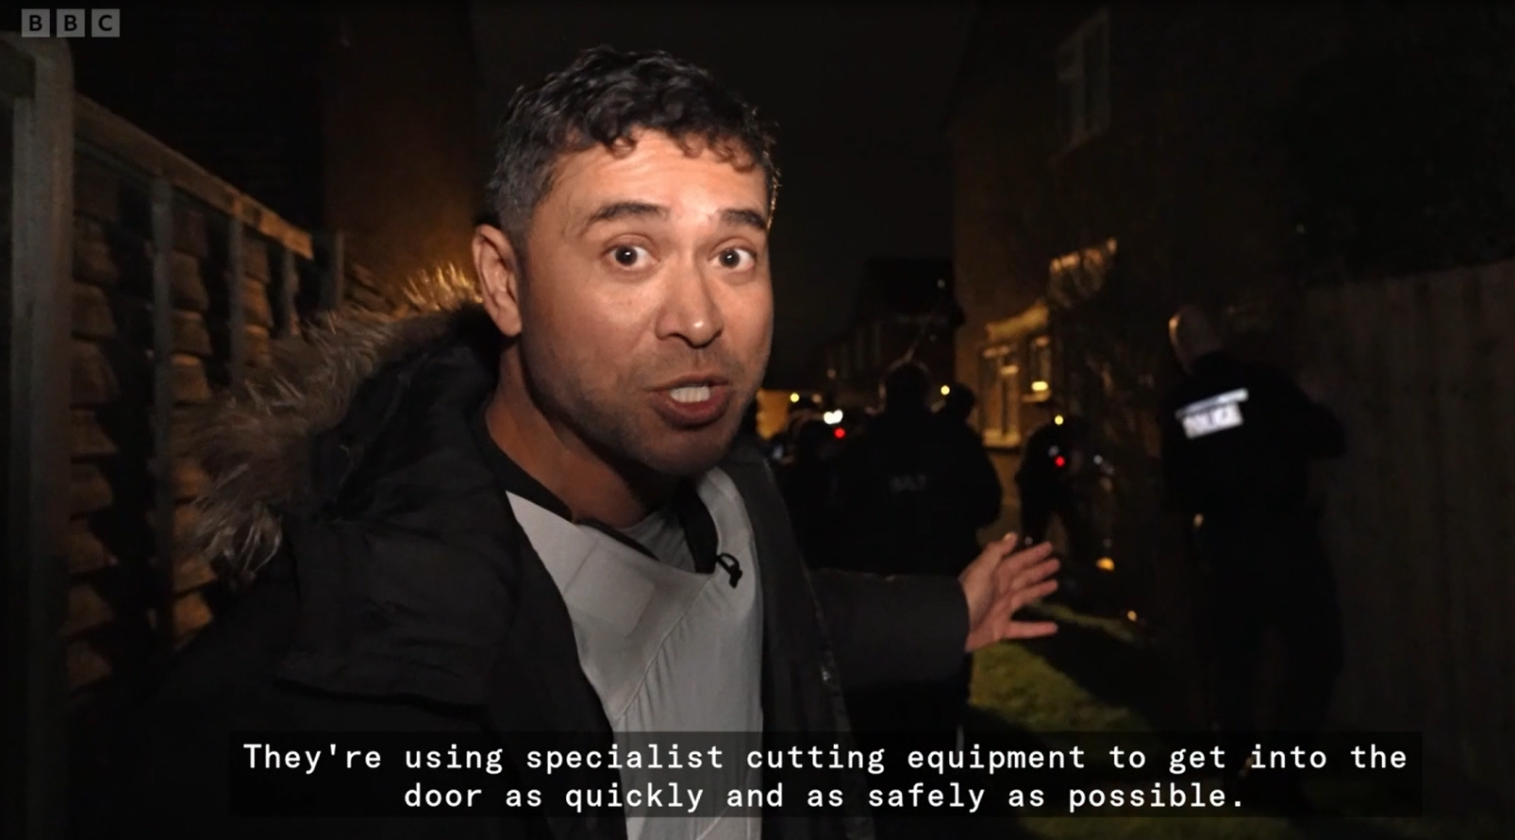
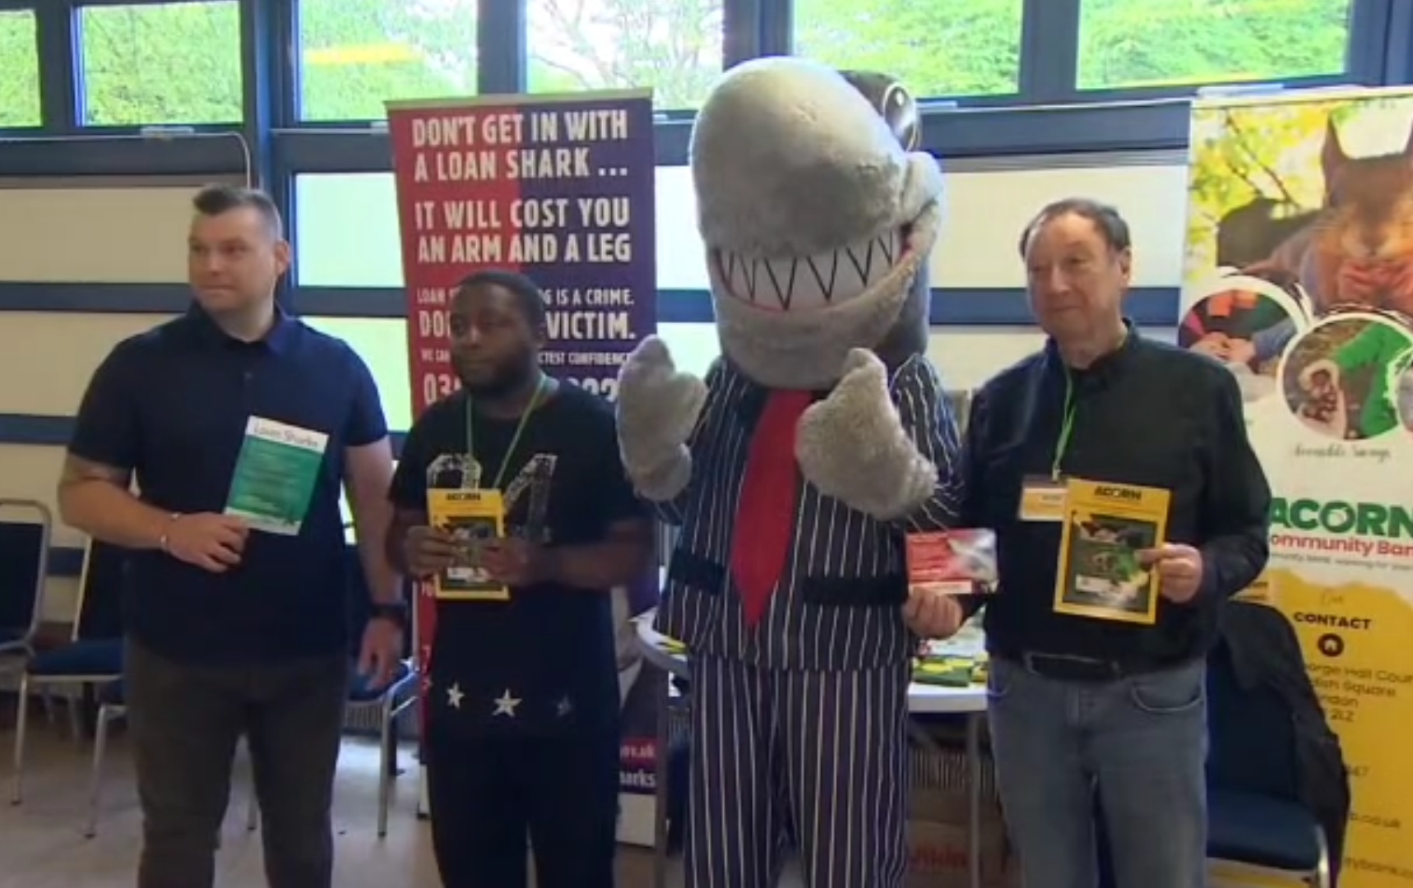

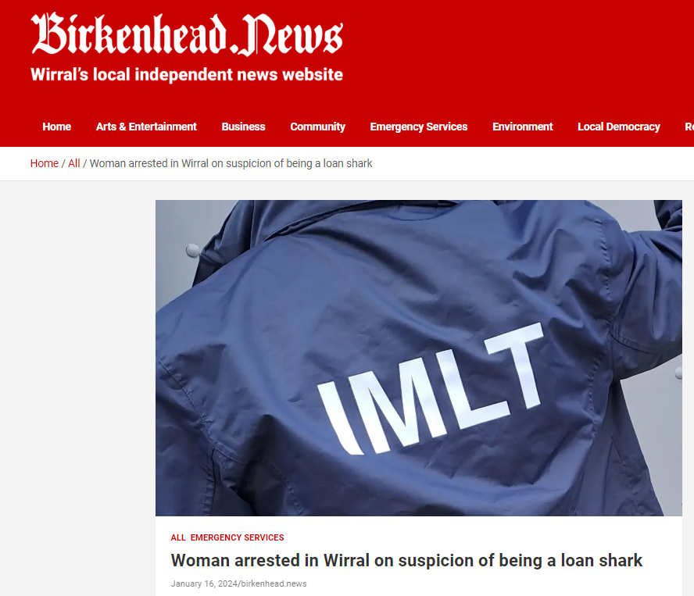

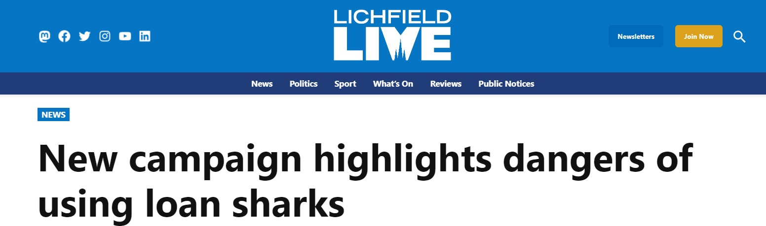
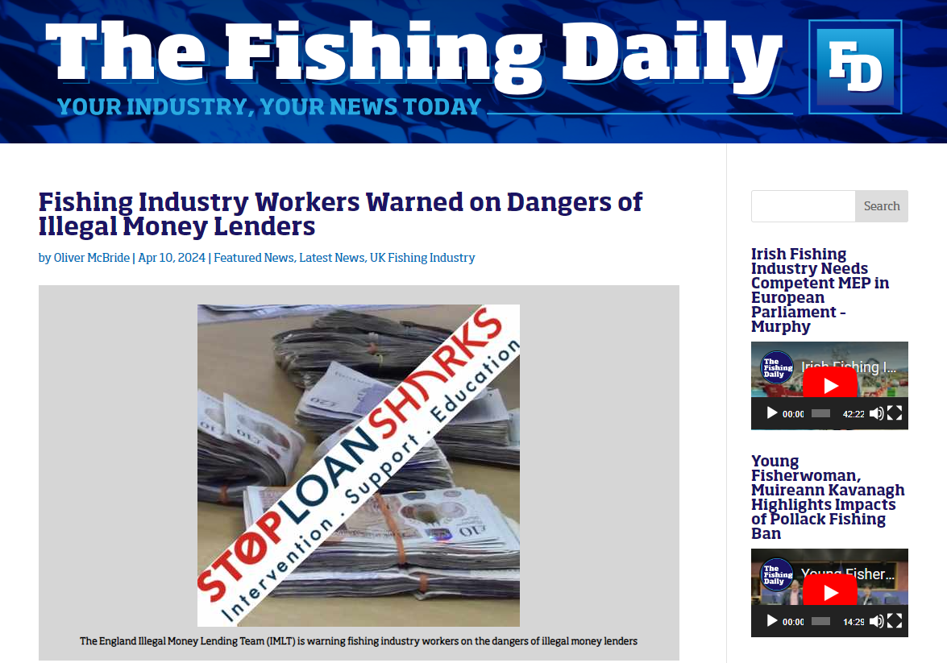
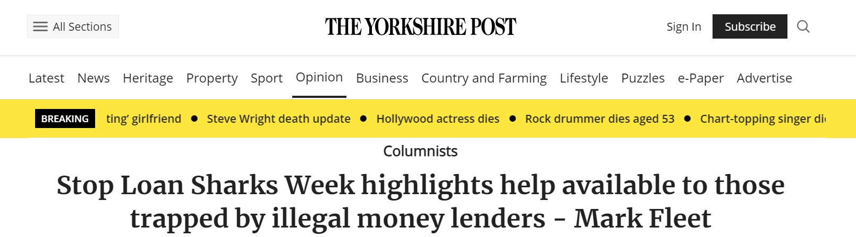
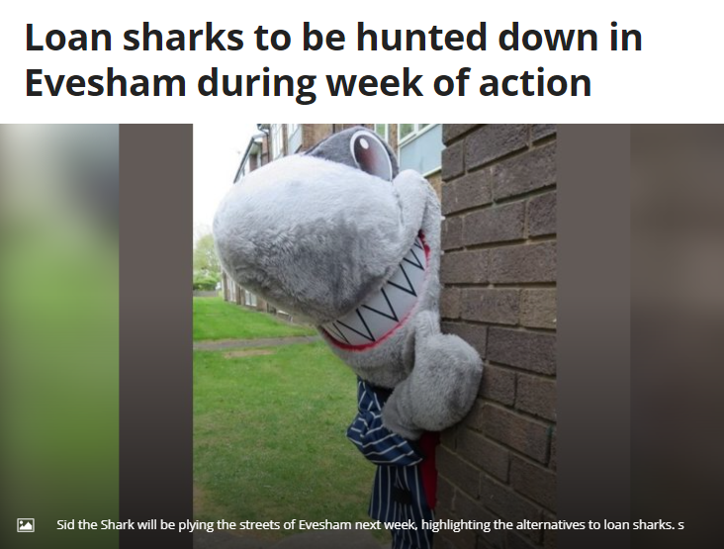
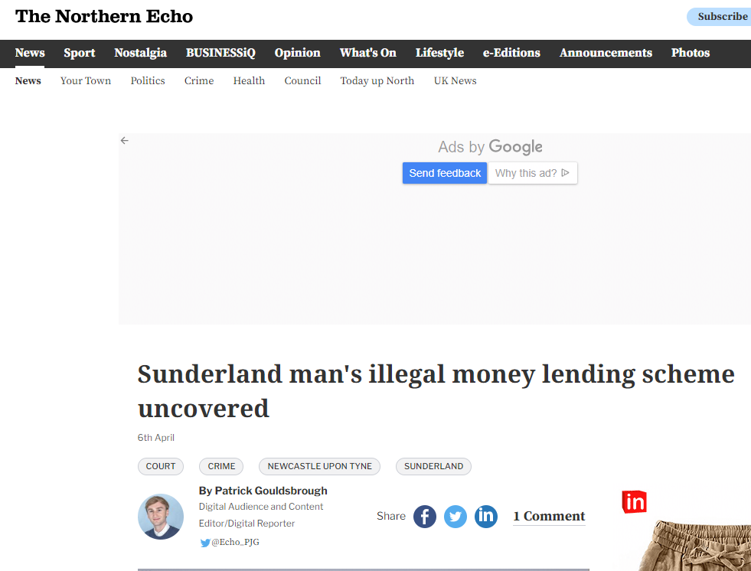
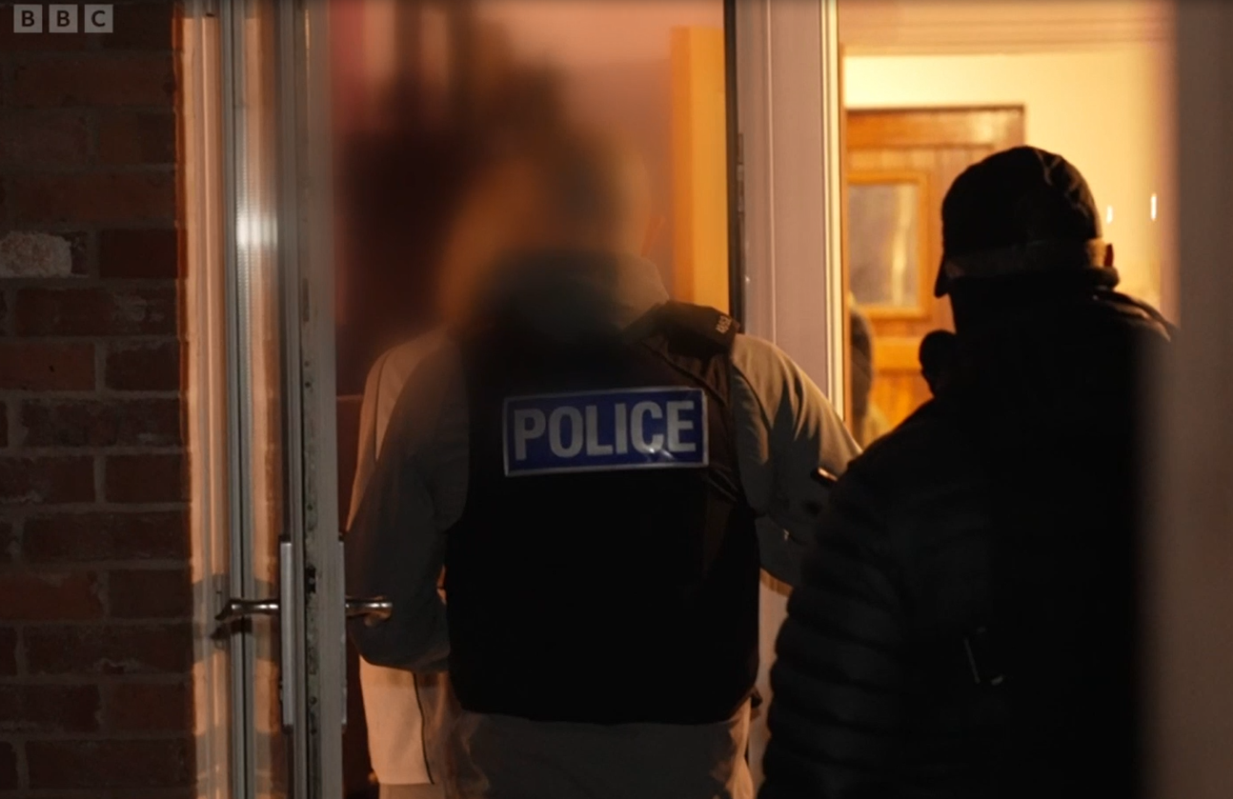

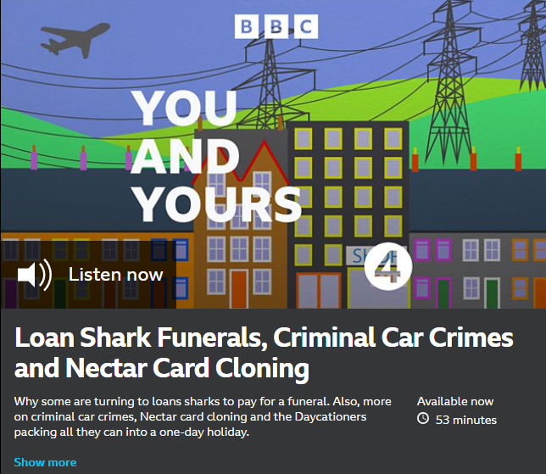
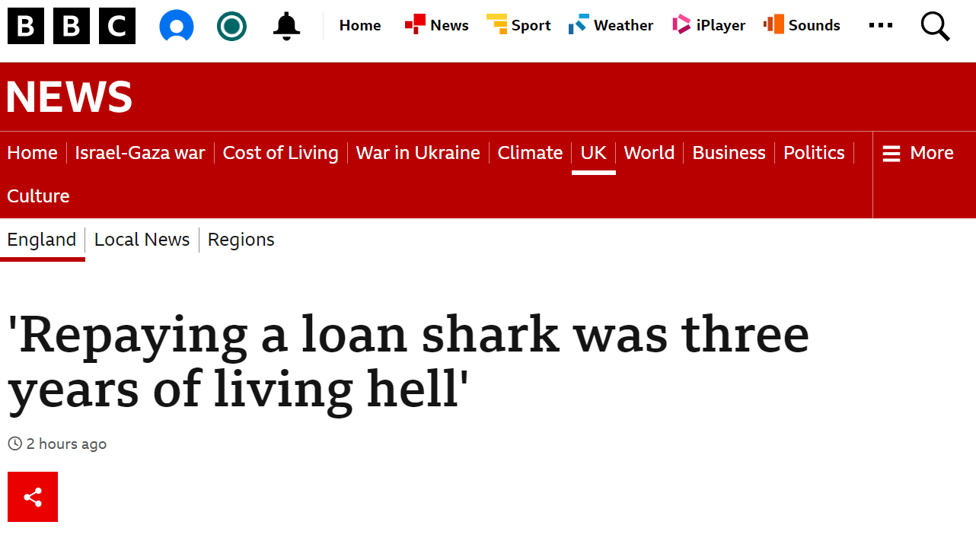



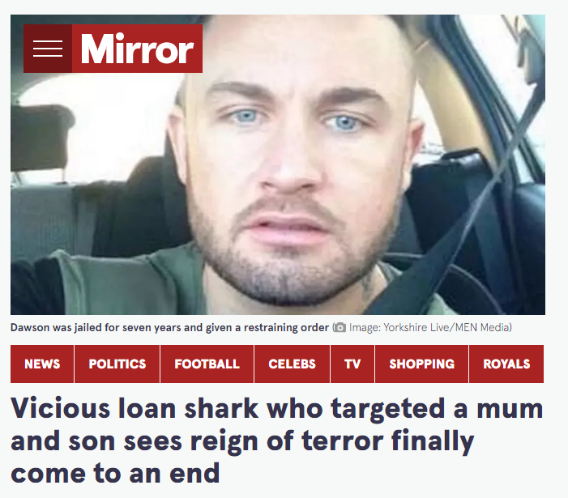
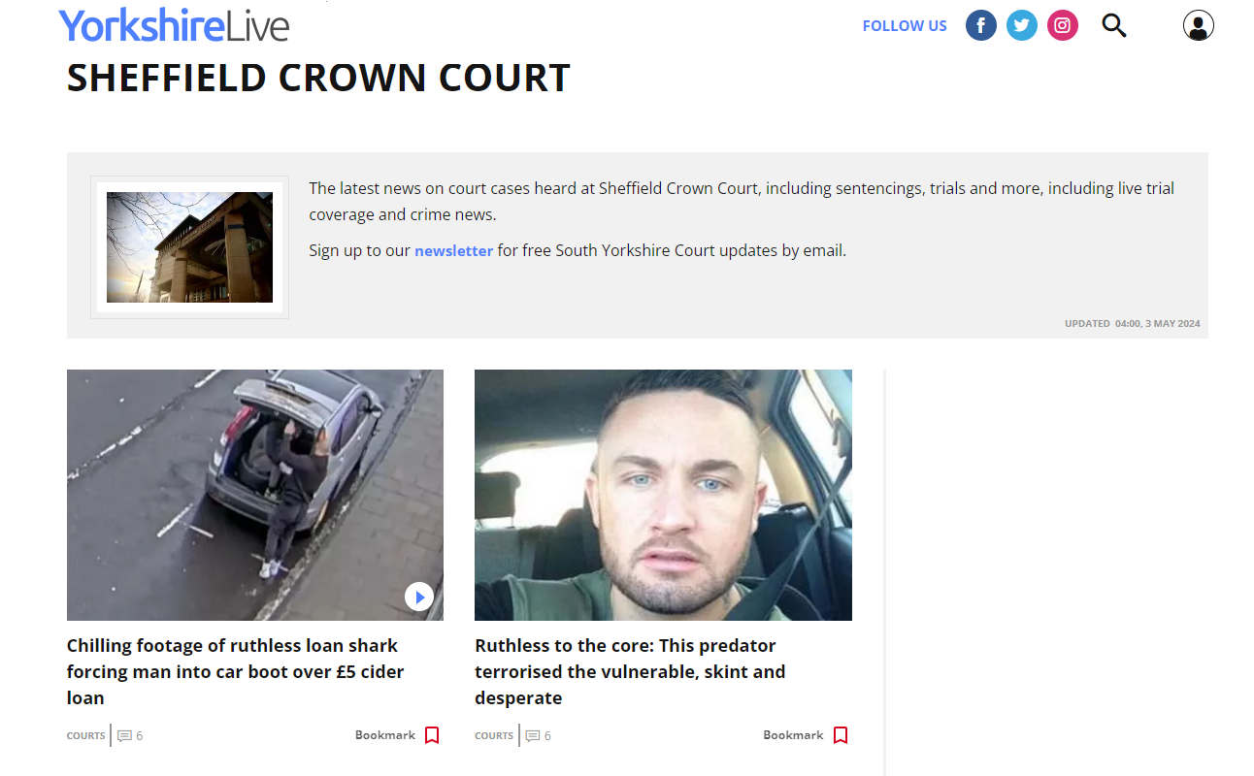
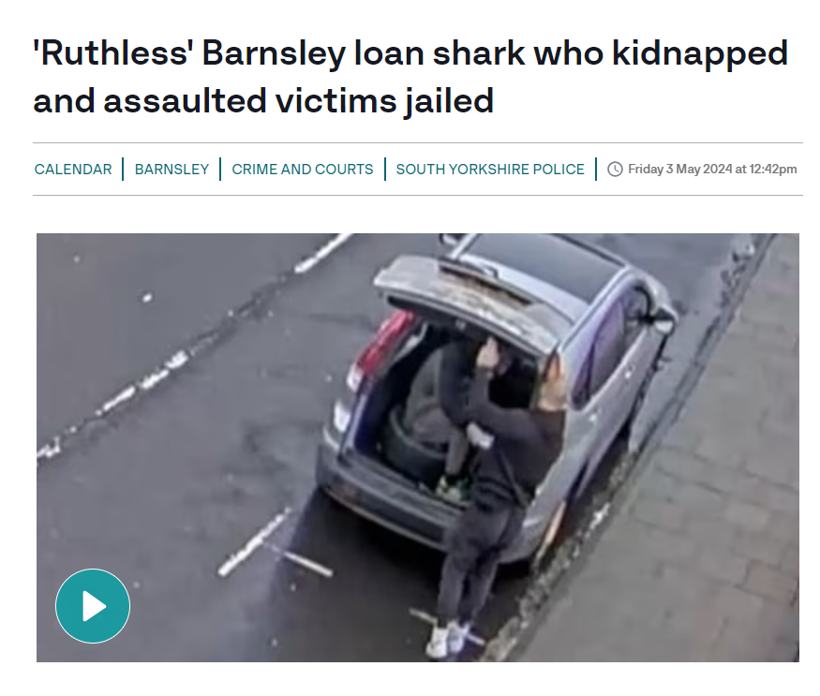


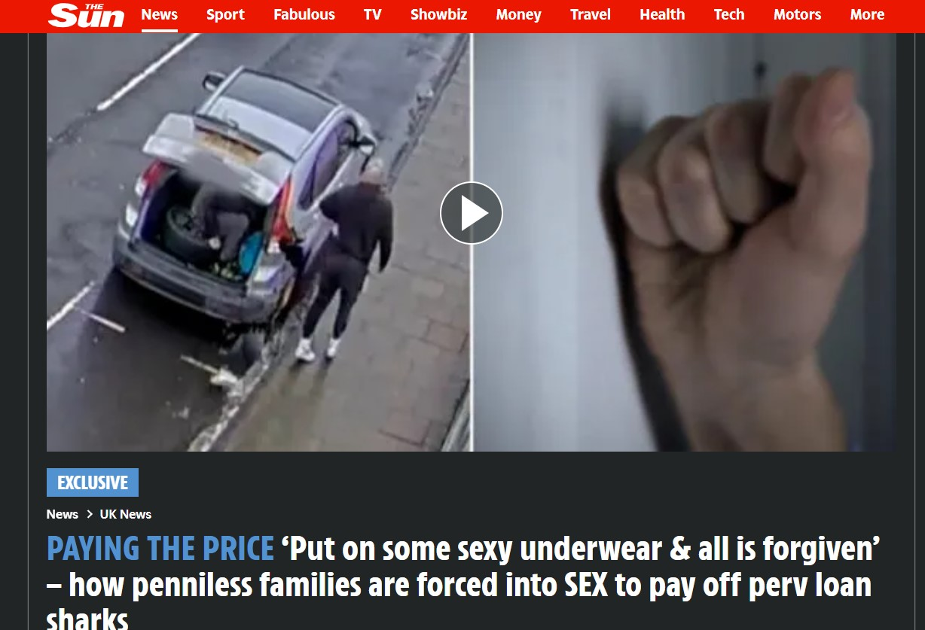
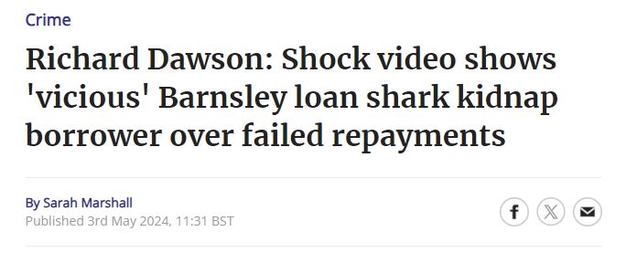
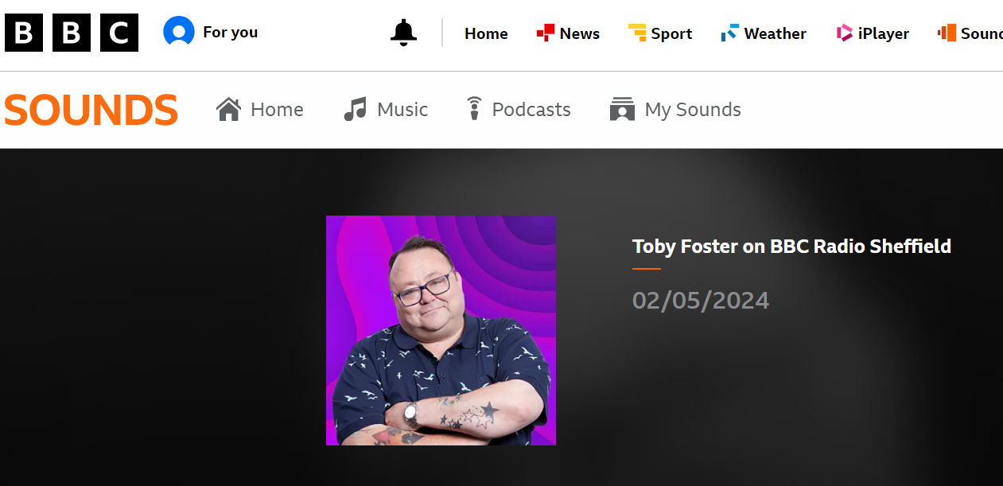


Stop Loan Sharks in the news

Slide 10
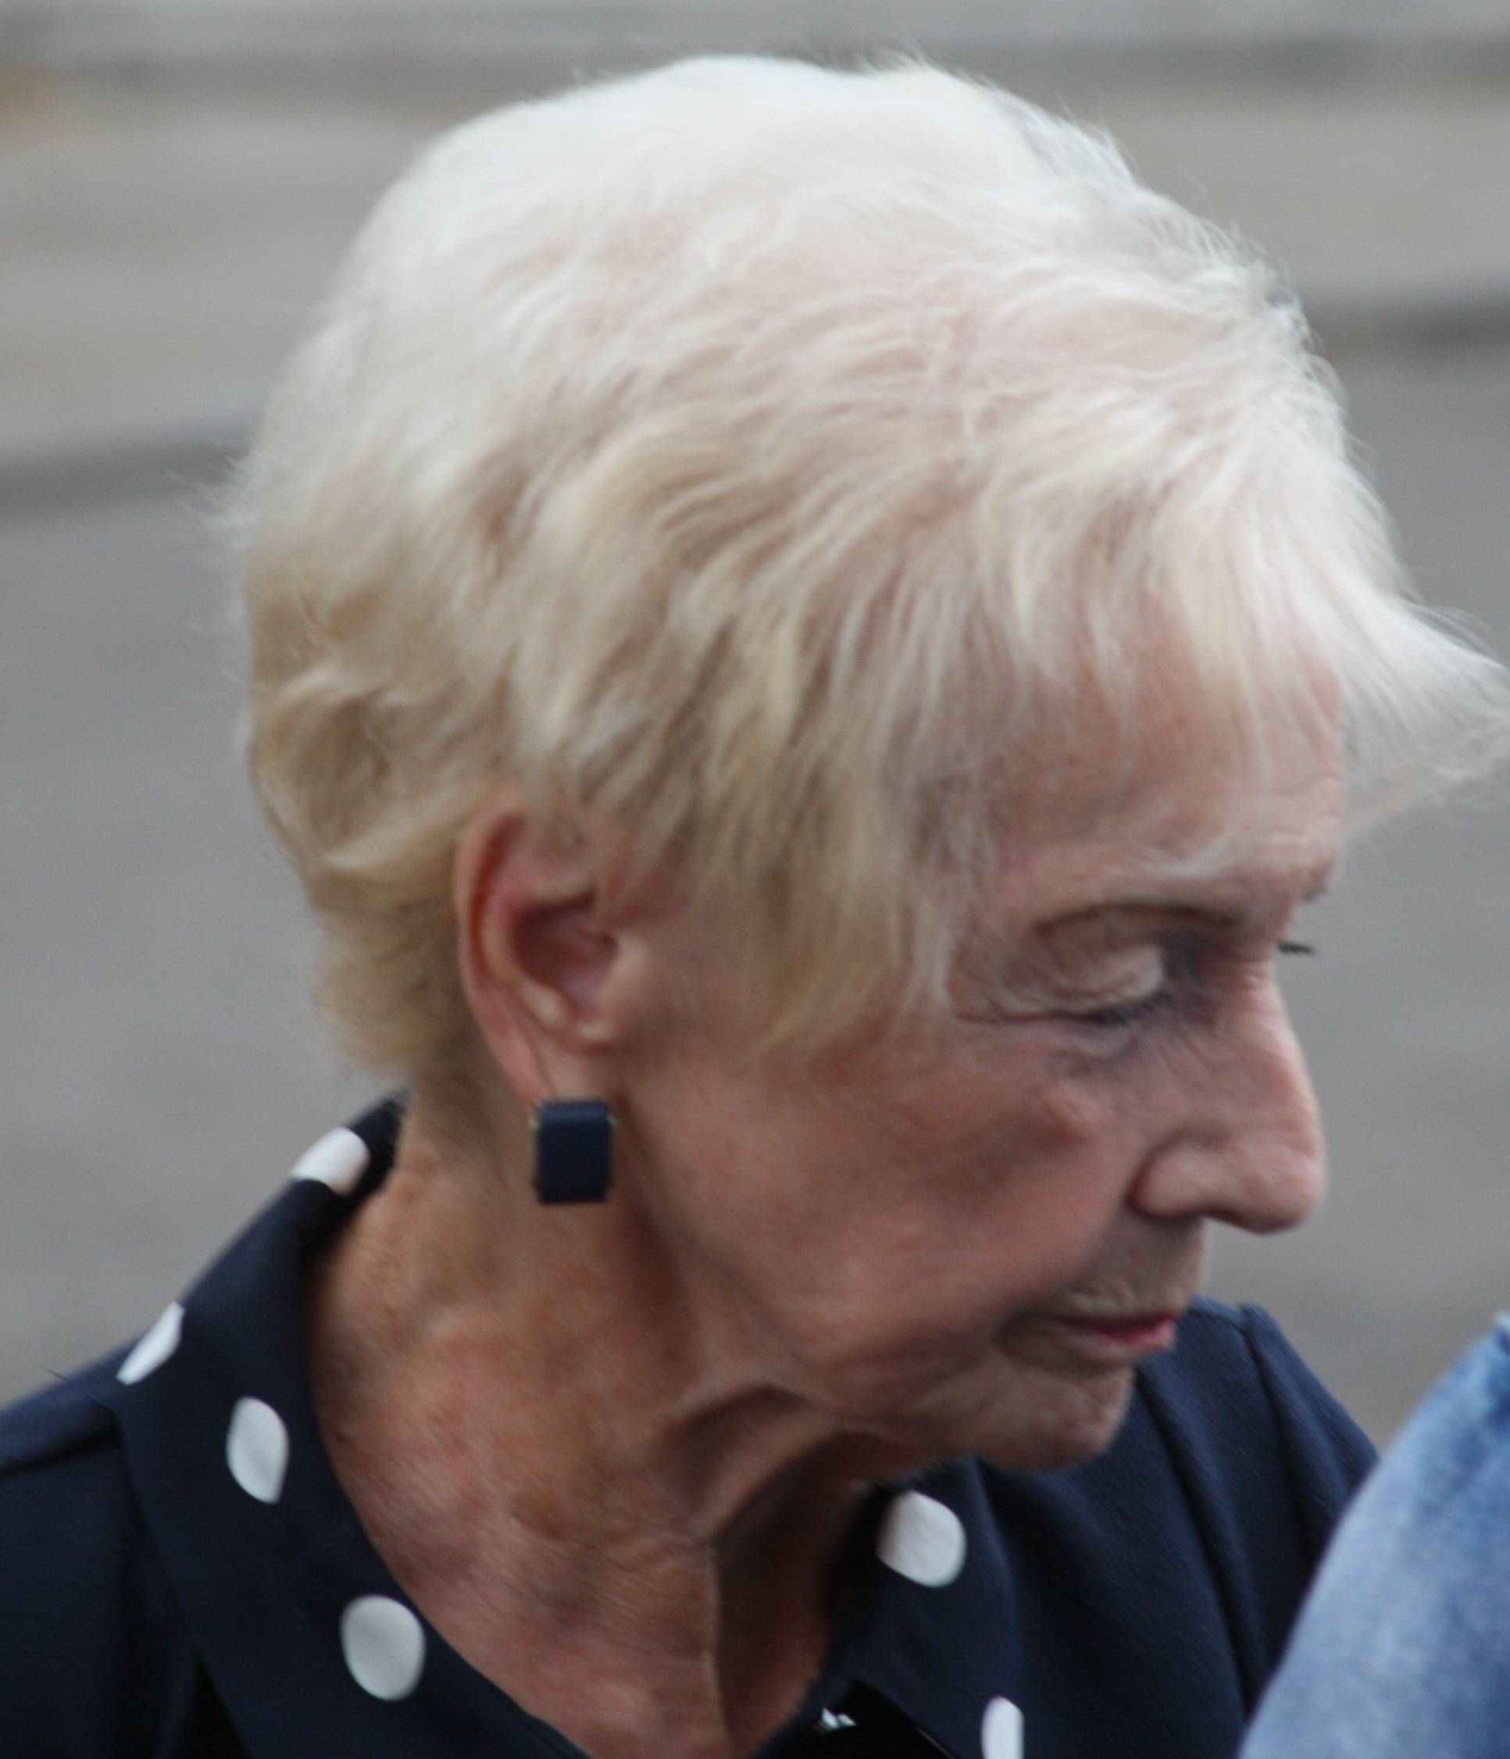

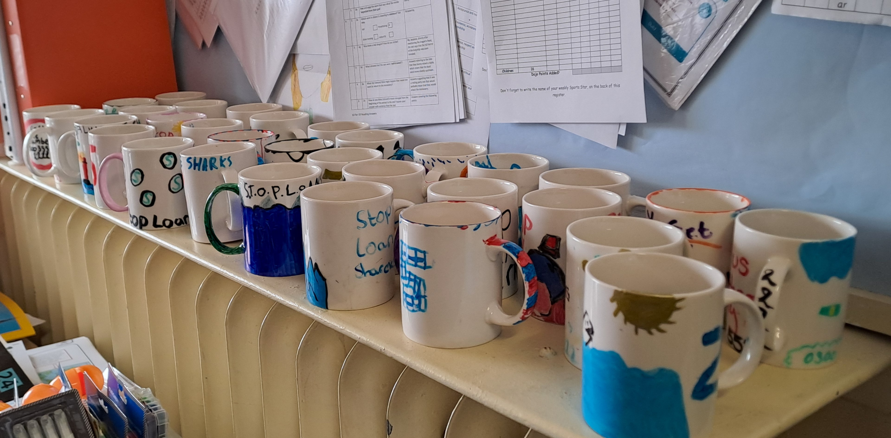
News from Wales: 83-year-old loan shark is ordered to pay £173,000
An 83-year-old loan shark was ordered to pay back over £173,000 of her ill-gotten gains.
Tabitha Richardson, from Newport, will have to sell her home to raise the funds a Proceeds of Crime Hearing at Cardiff Crown Court was told in April. If the money isn’t paid back within three months she potentially faces 21 months in prison. The case came to light in August 2020, when Richardson’s property in Nash Road, Newport, was raided by officers working for Stop Loan Sharks Wales. £6,500 in cash was found in a safe which had to be broken open by a locksmith, as well as bank books, lending books, files, and other paperwork. An investigation was launched which resulted in Richardson pleading guilty to illegal money lending, engaging in an activity requiring a licence, carrying out a regulated activity when not authorised or exempt, and money laundering.
Despite Richardson’s age, it became clear during the investigation that if payments were missed by her victims, threatening and menacing messages would be sent to borrowers.
Tabitha Richardson, aged 83
Back to school campaign
What’s in store for our 20th anniversary?
Kitting out pupils ready for a new school year can be costly – especially when you have more than one child.
We know this is a tough time for parents and carers and it is inevitable that some will need help to afford everything needed. That may leave them vulnerable to loan sharks. We want to make sure people know where they can borrow safely if they need to and where they can get support if they have been targeted by an illegal lender.
In the next few weeks we will have a social media toolkit ready to share so that you can get that message out to all your clients and customers ahead of the back-to-school rush.
We have some big plans in the pipeline to mark our 20th anniversary in September this year.
We have already worked on a great project with Bidston Avenue Primary School in Birkenhead where pupils decorated some china mugs – to mark the china anniversary. Here is a picture showing some of their amazing designs.
There will be more to come on that and much more so watch this space!
In the meantime we’d love to hear some of your favourite recollections of working with Stop Loan Sharks over the years – any particular successes or highlights that you would like to share?
Email us at press@stoploansharks.gov.uk and let us know.
Toolkits and resources can be downloaded from the website:
www.stoploansharks.co.uk/social-media-toolkit-3-2/
Keep an eye on our socials for more details:
Facebook - @StopLoanSharksEngland
Instagram - @stoploansharksengland
X - @SLSEngland
TikTok - @stoploansharks
LinkedIn - @stoploansharksEngland
Got information about loan sharks? Email us 📧 0300 555 2222 ☎️

