Slide 1

Empower your employees and raise productivity
The benefits of partnering with a credit union.
Presented to:
Name, Position, Company
By:
Name, Position, Company
Date

Slide 2

We are a credit union
As a credit union, we aim to put members in control of their own finances, promoting sound money management and helping them access money responsibly.
[A SENTENCE ON YOUR CREDIT UNION’S HISTORY]
Our payroll saving, loan and [SERVICE] services can make a significant improvement to your employees’ mental health and productivity.
This presentation has been produced in association with the Stop Loan Sharks initiative, for more information visit www.stoploansharks.co.uk

Slide 3
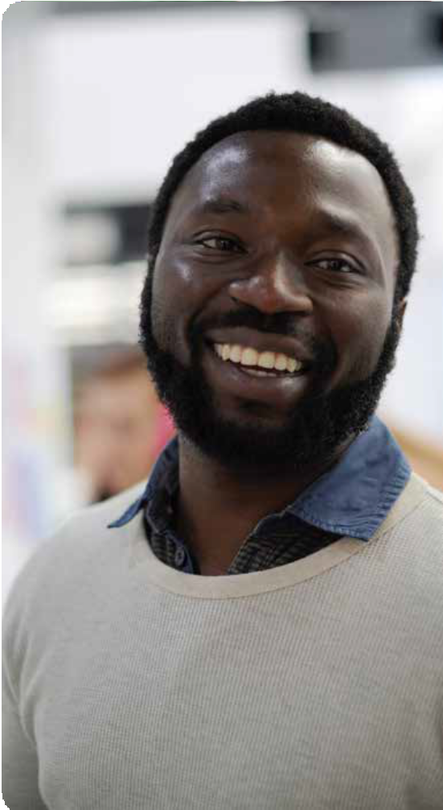
The financial wellbeing of your employees is vital – for them and even for you
The impact of debt upon an individual’s health is now well-researched and widely accepted.
Research also shows this can directly affect the ability to focus and work effectively.
Financial worries affect both mental and physical health
Ability to work can be significantly reduced
Stress of money worries may even lead to absenteeism and presenteeism
Those with money issues are unlikely to make them known
This presentation has been produced in association with the Stop Loan Sharks initiative, for more information visit www.stoploansharks.co.uk

Slide 4

Loan sharks in the workplace
If there is lending of significant sums of money within your staff, you will most likely be unaware of it.
This would typically be a sackable offence
This kind of lending is not simply money passed around between friends
Staff that lend colleagues money could be exerting power over those they have lent money to
This presentation has been produced in association with the Stop Loan Sharks initiative, for more information visit www.stoploansharks.co.uk

Slide 5

How can you address this?
Understanding that financial stability may be an issue for your workforce is the first step.
Make staff feel comfortable about discreetly raising the issue
Formal support requires a responsible provider of financial services
A credit union is an ideal and trustworthy financial organisation
This presentation has been produced in association with the Stop Loan Sharks initiative, for more information visit www.stoploansharks.co.uk

Slide 6

How can we, as a credit union, help you?
There are many benefits to partnering with us.
You can offer our services to your staff as a free benefit
We handle most of the admin
Staff can join the credit union directly, putting them in control
Our savings scheme encourages better financial planning
Payroll loans allow members to borrow safely at a fair APR
This presentation has been produced in association with the Stop Loan Sharks initiative, for more information visit www.stoploansharks.co.uk

Slide 7

What does it cost me?
This is often the first question we are asked.
No money is payable by you to partner with us
Your only cost is a small amount of internal admin on your part
Staff pay into their savings and pay back loans through your payroll
Credit unions are non-profit organisations run to benefit members
This presentation has been produced in association with the Stop Loan Sharks initiative, for more information visit www.stoploansharks.co.uk

Slide 8

What is a payroll loan?
A payroll loan is a method of borrowing that allows the borrower to repay directly from their salary.
Responsible borrowing period makes the loan manageable
Safer than many forms of commercial short-term lending
Repaying through salary deductions makes borrowing convenient
A form of borrowing that encourages a healthy financial life
This presentation has been produced in association with the Stop Loan Sharks initiative, for more information visit www.stoploansharks.co.uk

Slide 9
Thanks for listening!
Any questions?

